Slide 1
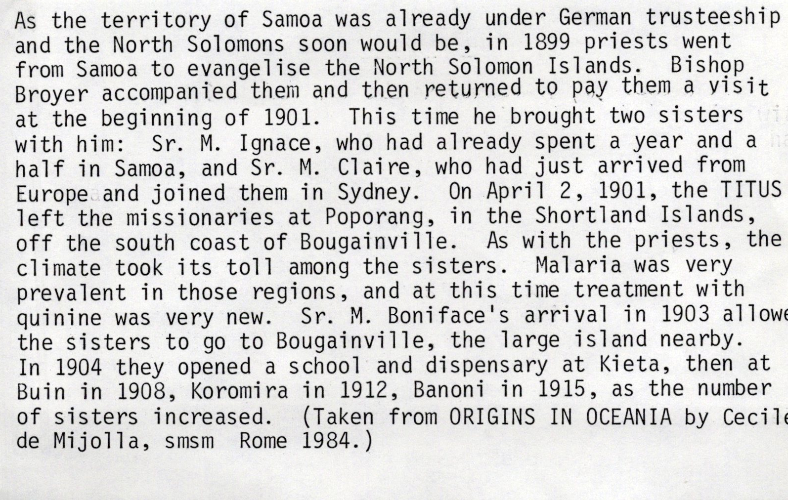
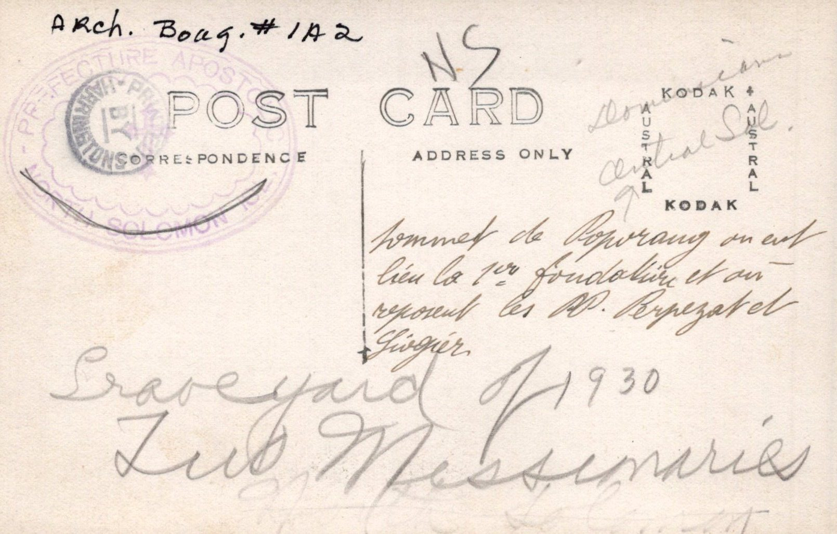
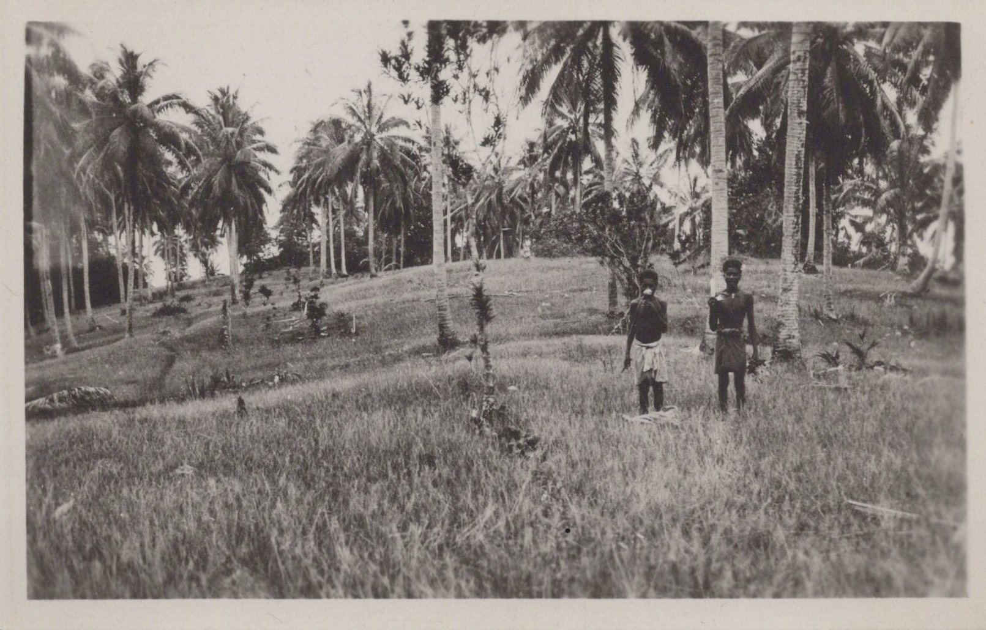
Left: Original Introduction to Bougainville Photographic Files
ARCH III. Files
Below: inscription, back of Postcard
Below: At the top of Poporang where the first foundation was made in the North Solomons Vicariate.
This is where two of the first Marist priests were buried, Fathers Perpezat and Georgier. Postcard.

Slide 2
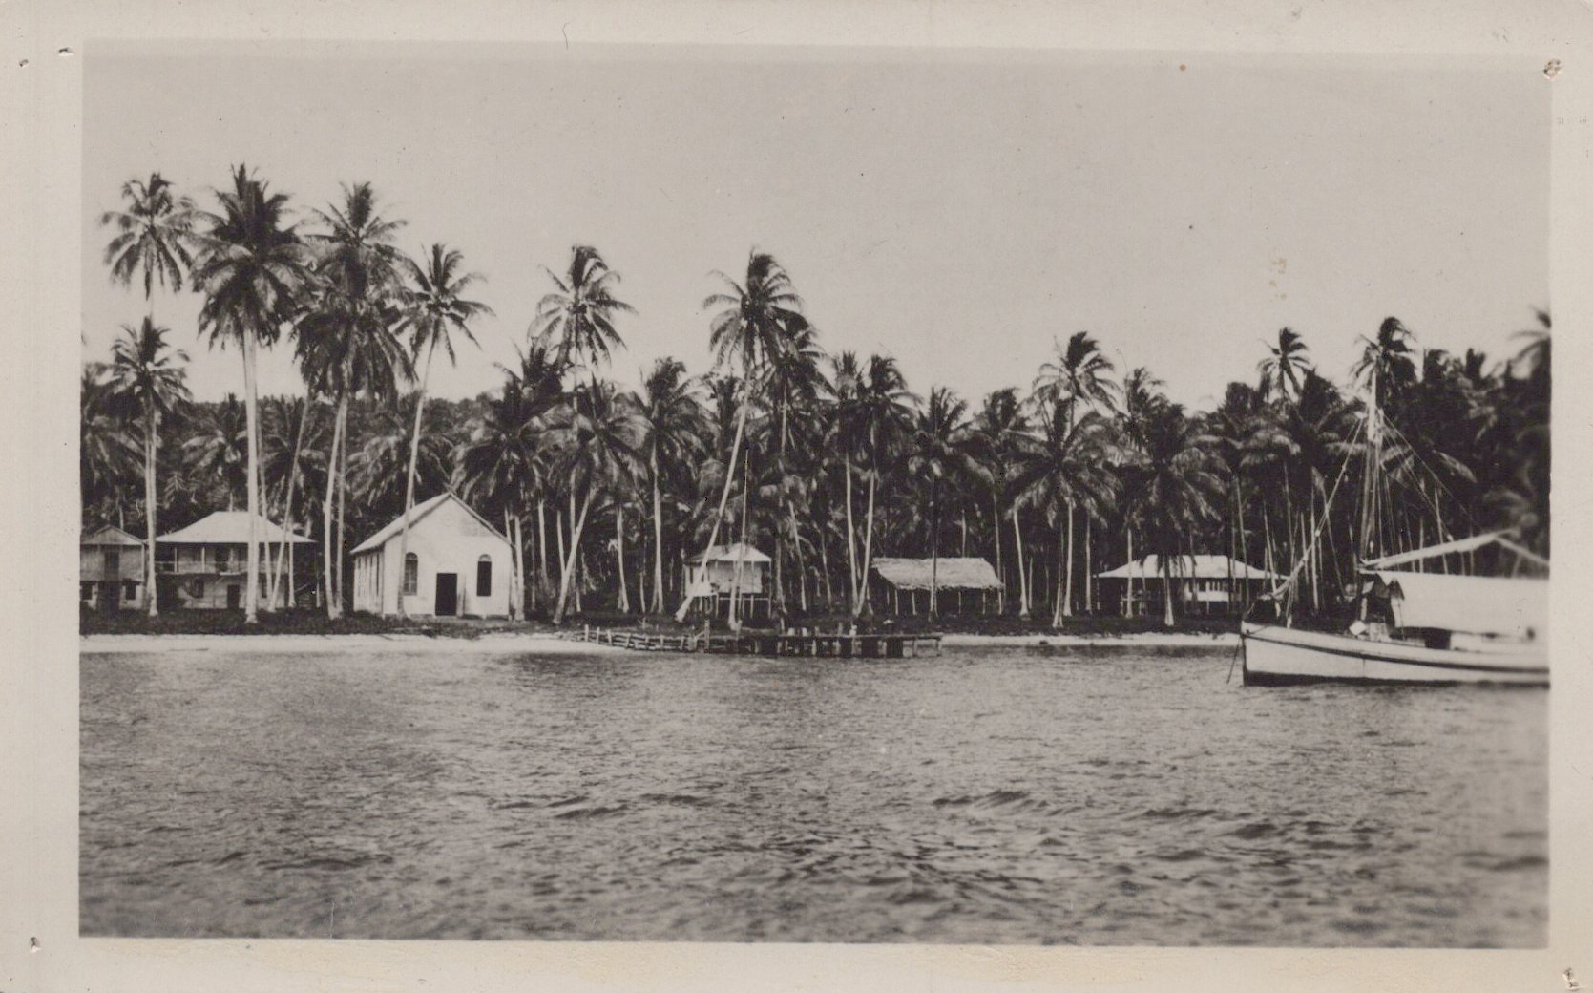
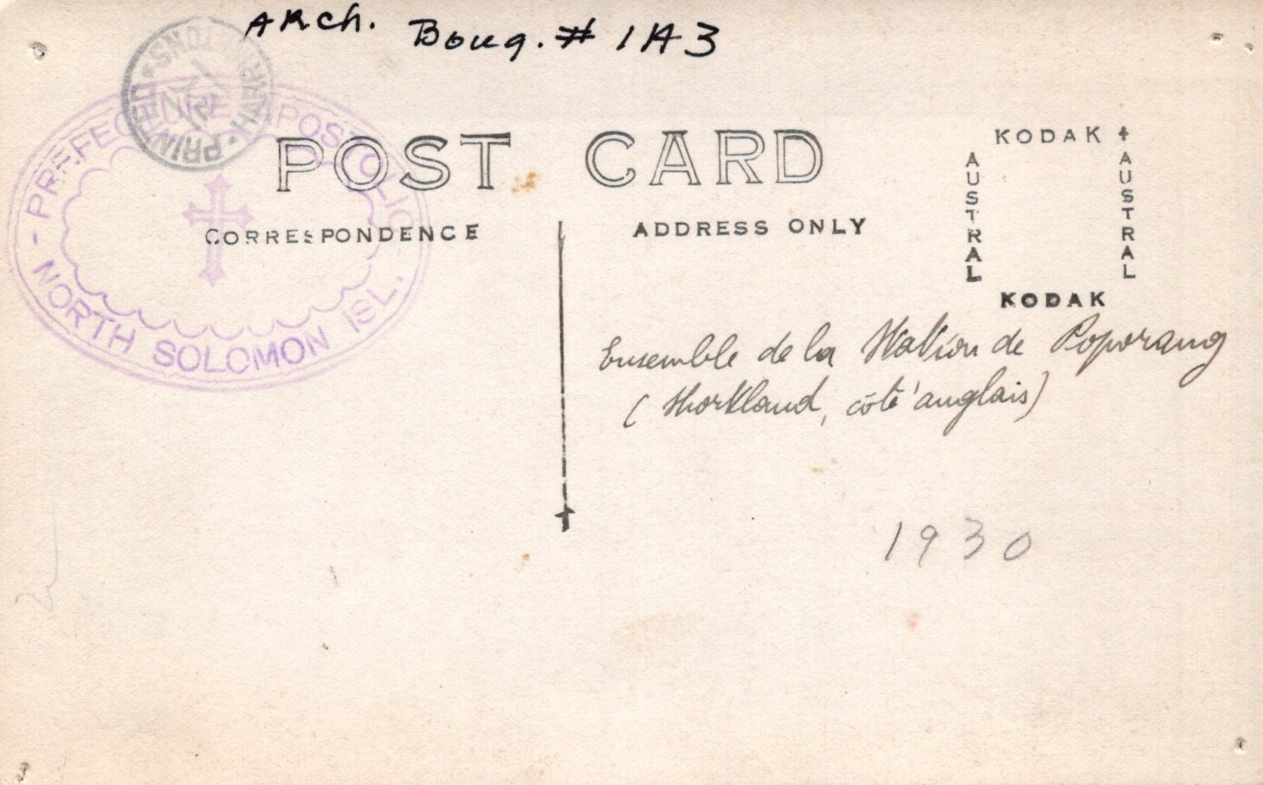
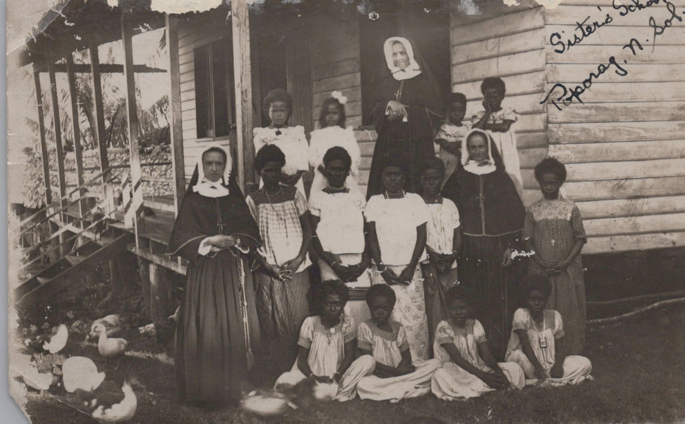
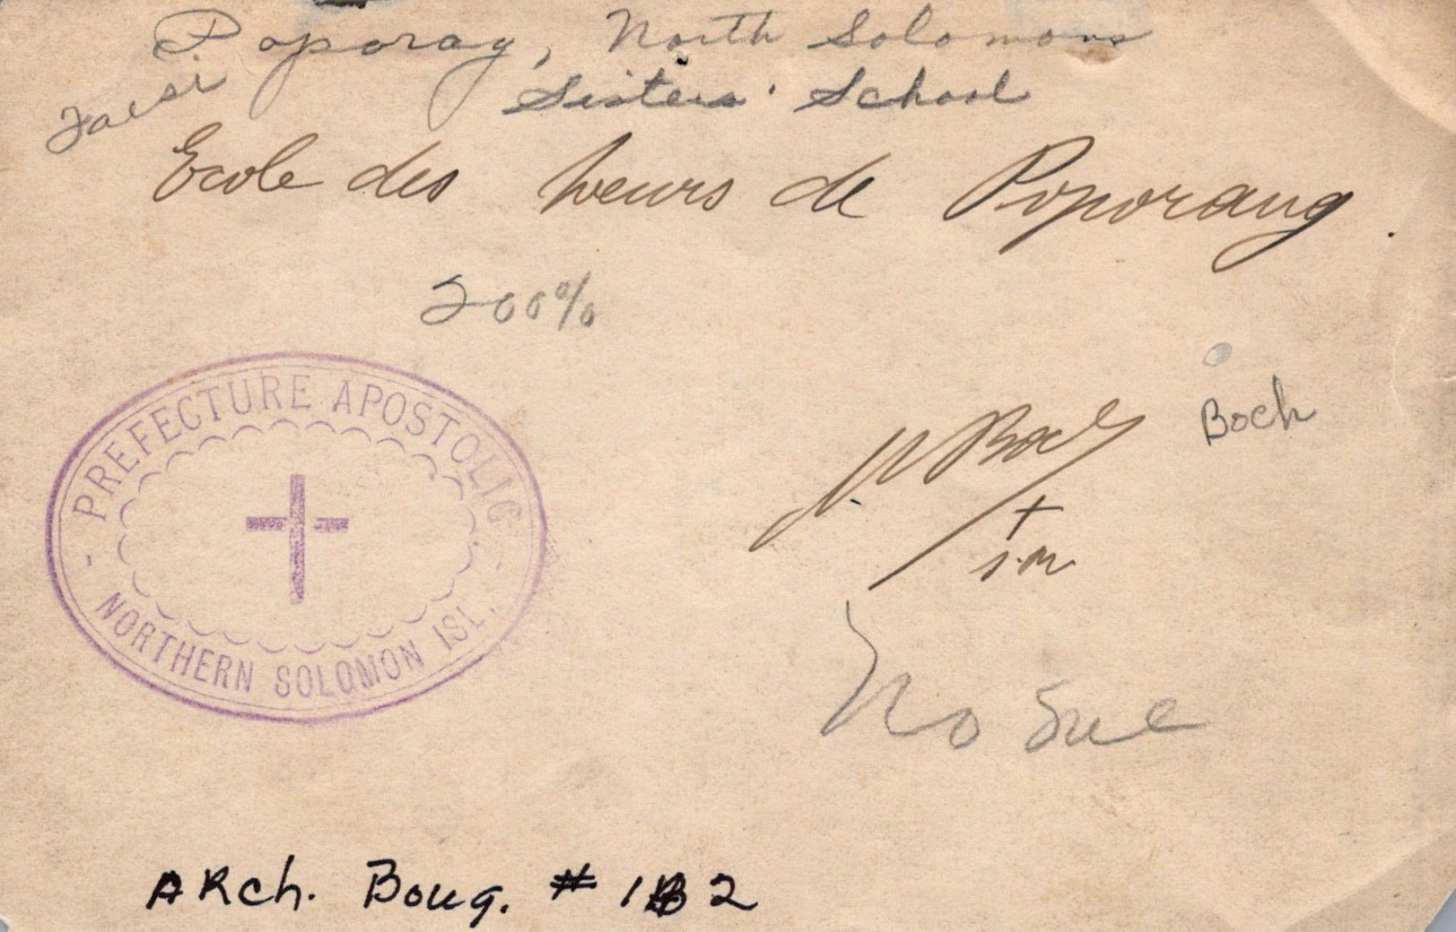
Left: Back, inscription,
Poporang Mission Station.
Postcard
Above: Mission Station at Poporang showing the convent, chapel, school and native houses. Taken in 1930 Poporang station was in the Shortland Islands which laters became the Central Solomons. Postcard.
Below: Back, inscription, Sisters’ School Photograph
Left: Sisters’ School, Poporang North Solomons. Srs. M. Placide and Adelberta at Poporang with their school children. Photograph.

Slide 3
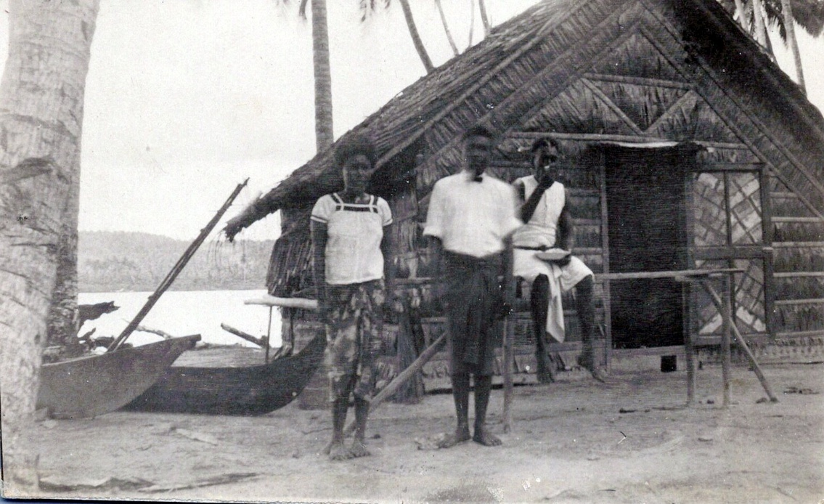
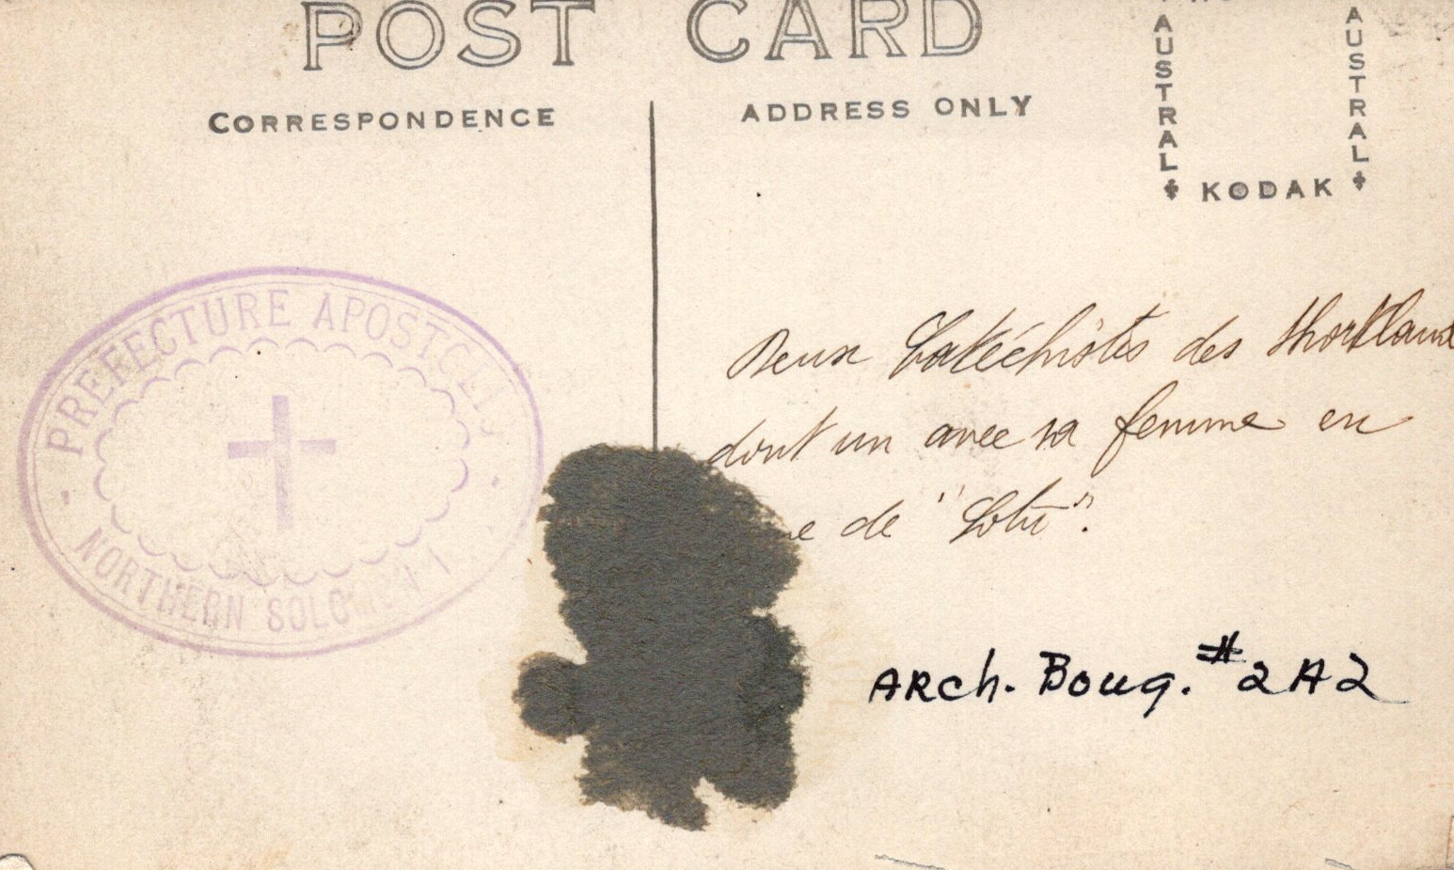
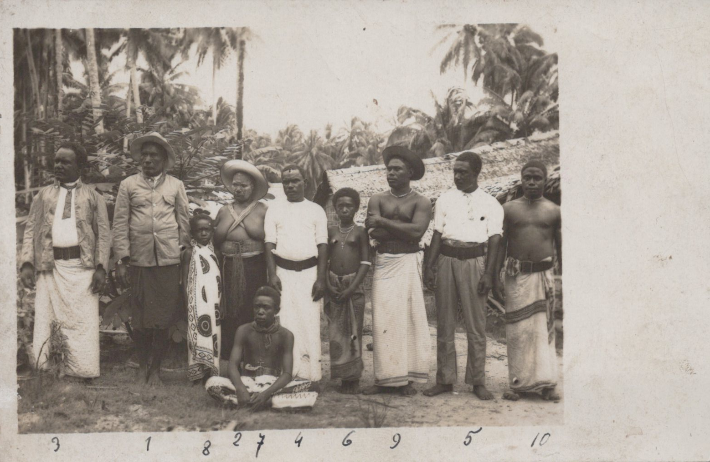
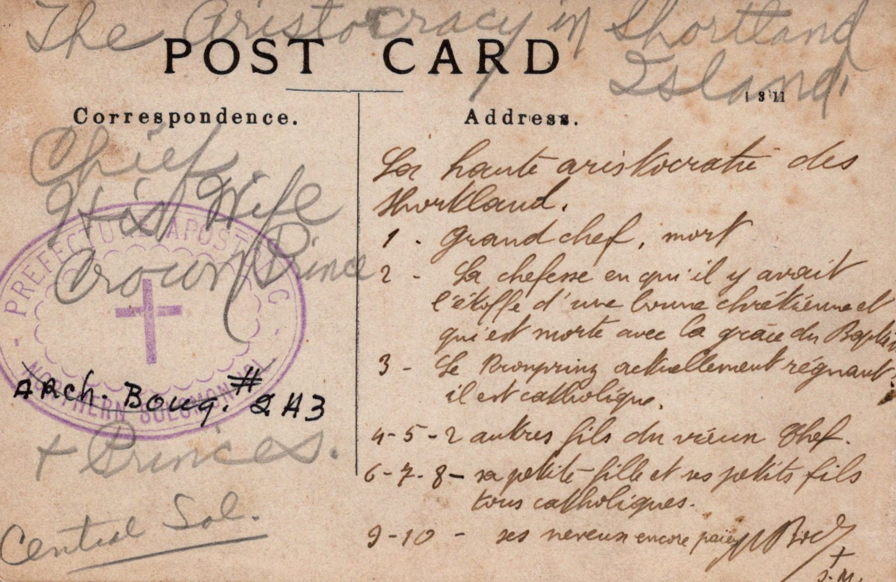
Left: Back, inscription: Shortland Islands, Two Catechists. Postcard
Above: Shortland Islands, Two Catechists—one has his wife with him. Postcard.
Left: Postcard featuring Great Chief and family. Numbers correspond to identified people in postcard. 1.) Great chief 2.) Wife of the chief who died after receiving baptism 3.) Firstborn of the chief 4-5.) Two other sons of the chief 6-8.) grandchildren of the chief 9-10.) Nephews of the chief—still “pagans.” Written by Fr. Boch, SM. 1930. Postcard
Right: Back, inscription, Great Chief and family. Written by Fr. Boch, SM. Postcard.

Slide 4
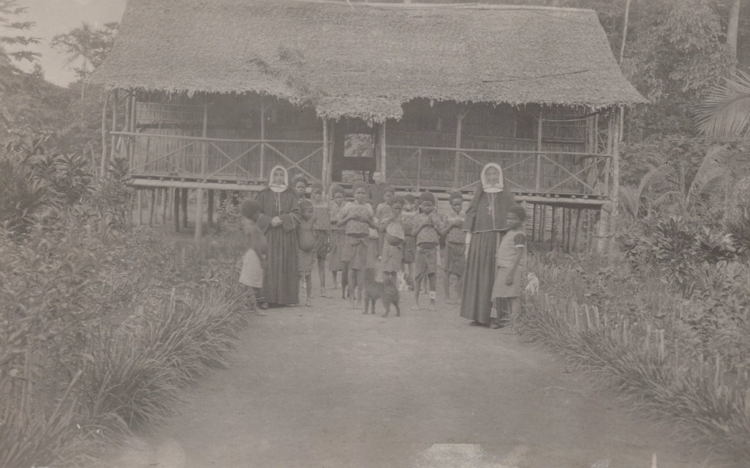
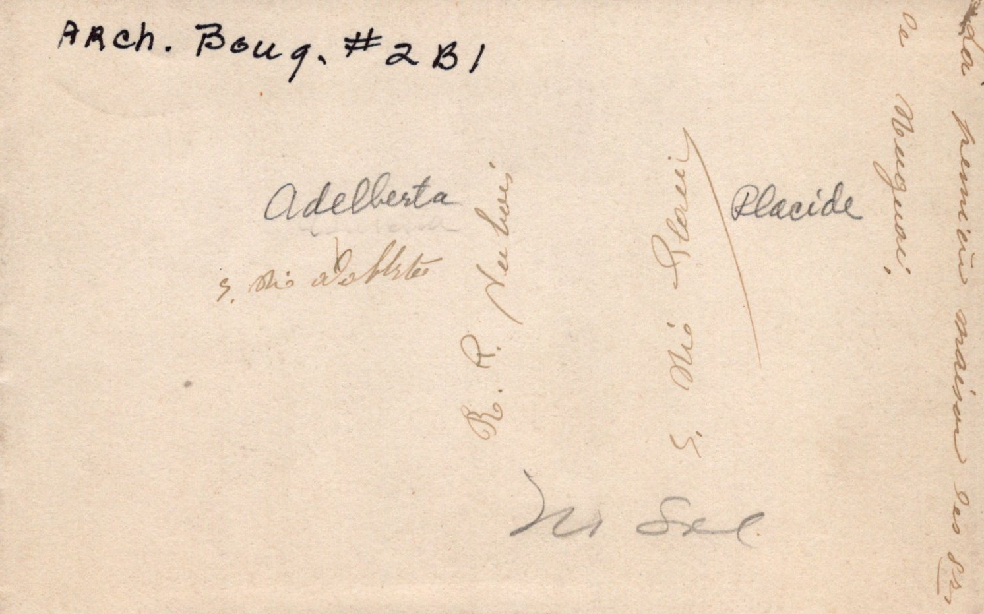
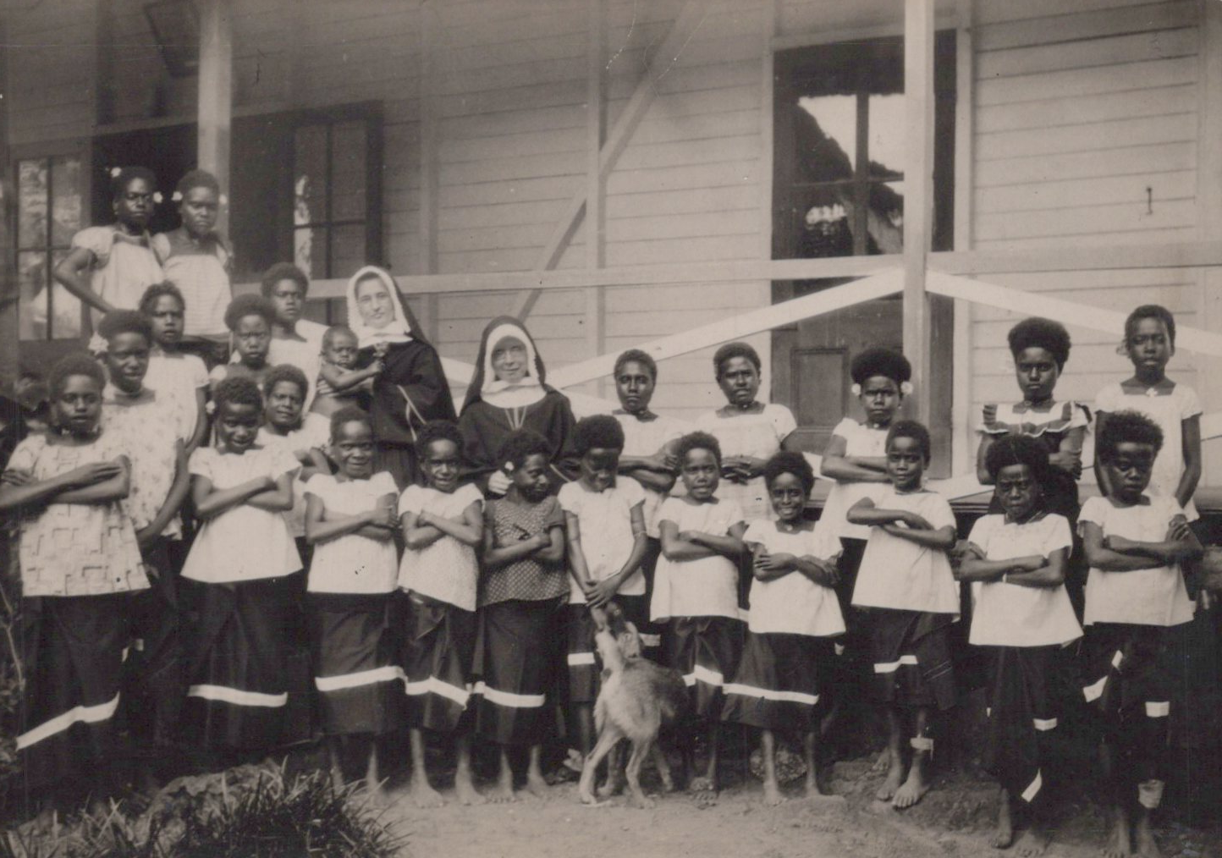
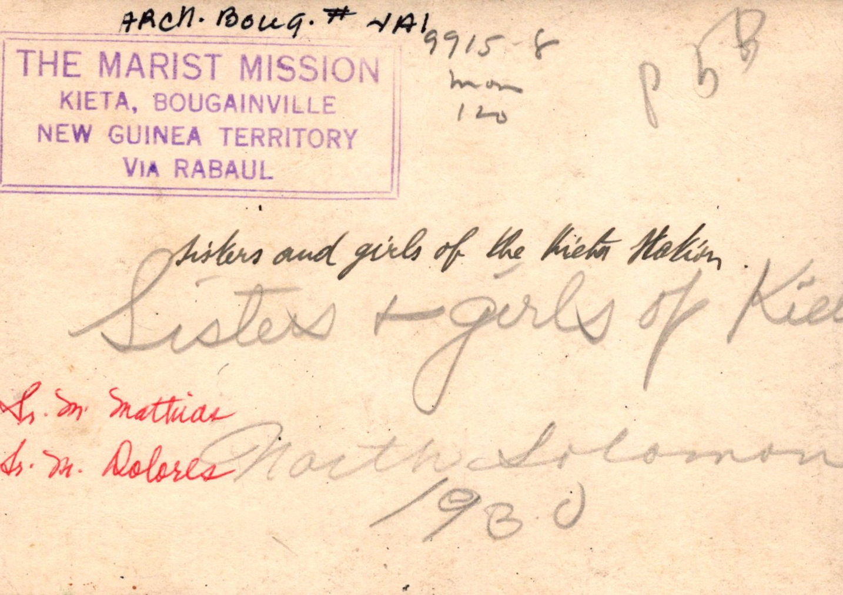
Above: Srs. M. Placide and Adelberta at Poporang. Photograph.
Above: Back, inscription, Srs. M. Placide and Adelberta at Poporang. Photograph.
Below: Srs. M. Mathias and Dolores with school girls at Marist Mission, Kieta, Bougainville, New Guinea Territory, 1930. Photograph.
Below: Back, inscription, Srs. M. Mathias and Dolores with school girls at Marist Mission, Kieta, Bougainville,
New Guinea Territory, 1930. Photograph.

Slide 5
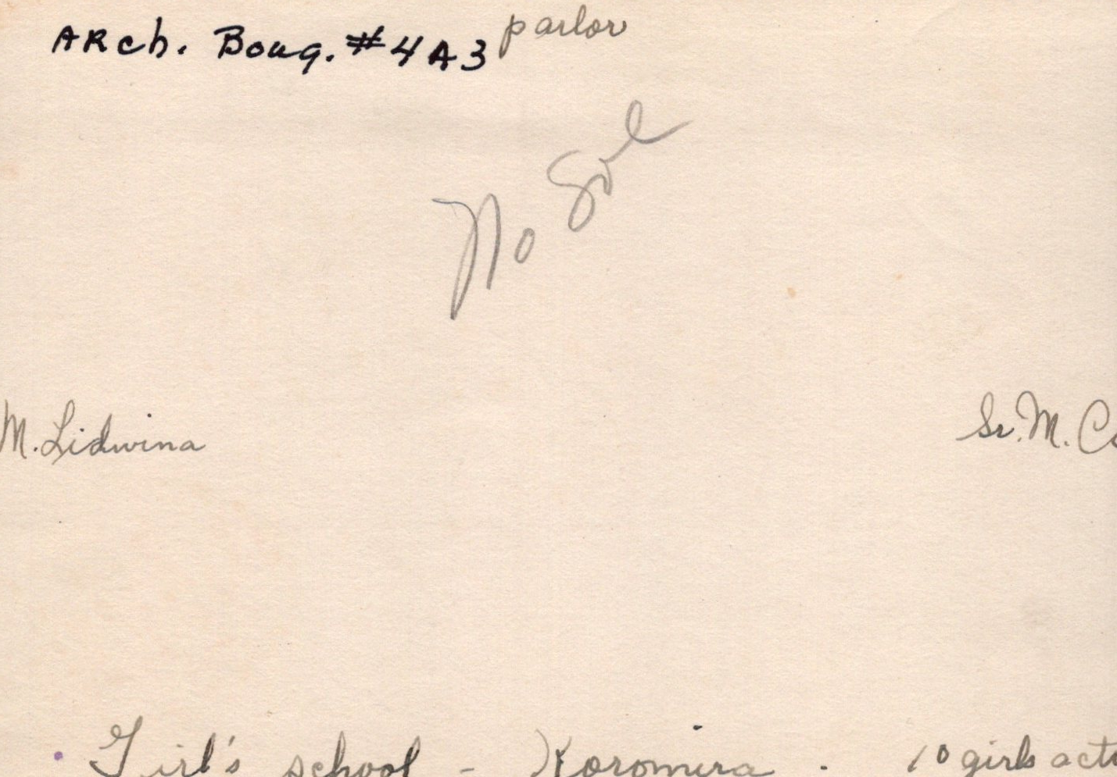
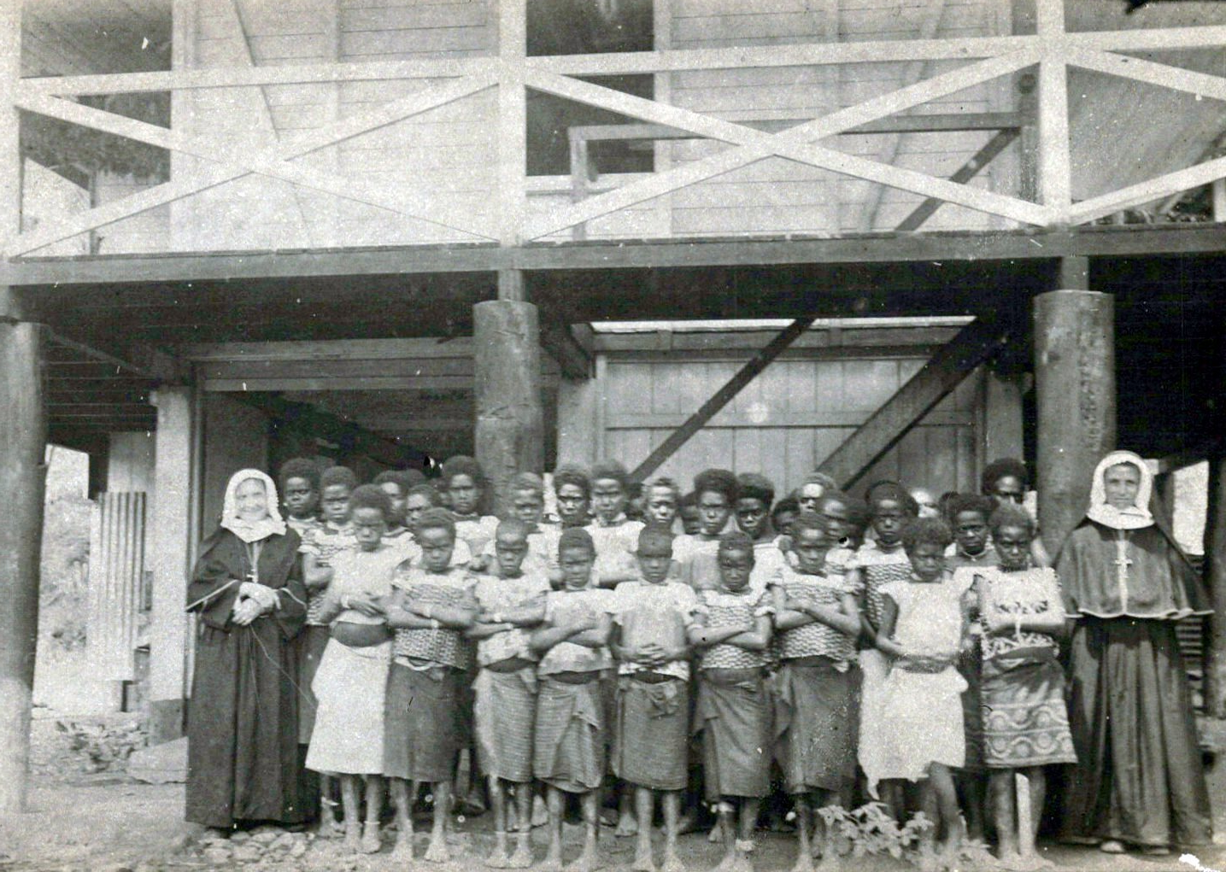
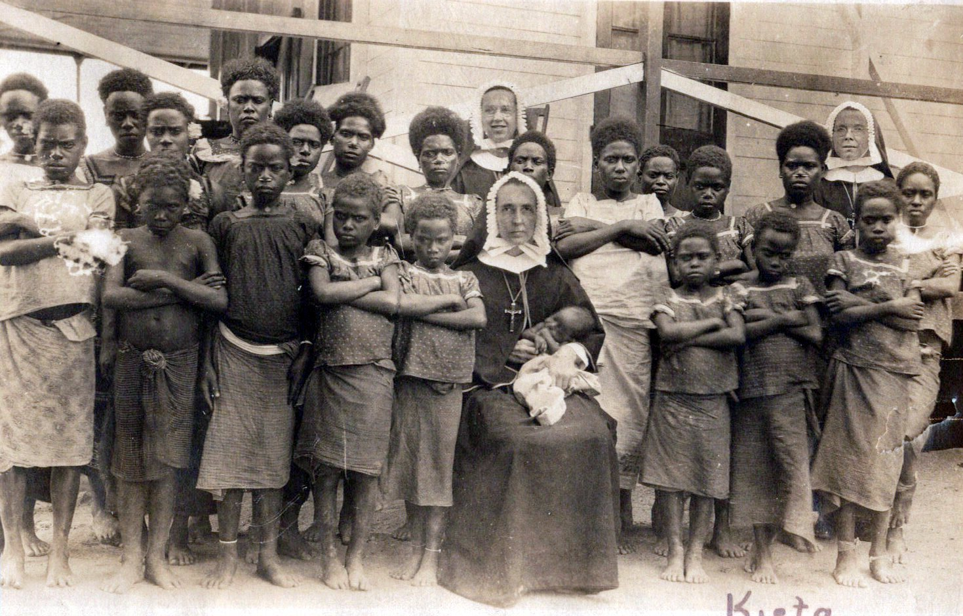
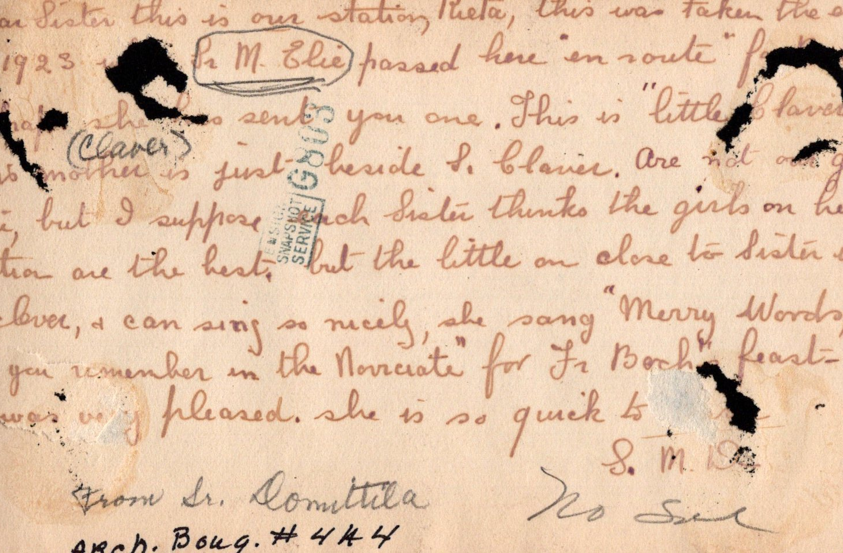
Below: Sr. M. Camille and Lidwina with school girls at Koromira, 1930. Photograph.
Above: Back, inscription, Sr. M. Camille and Lidwina with school girls at Koromira, 1930.
Left: Back, inscription, Srs. M. Claire, M. Elie, M. Domitilla. Notes cut off in parts, attributed Sr. Domitilla, 1923. Photograph.
Right: Sr. M. Claire (seated). Sr. M. Elie (standing left) and Sr. M. Domitilla (standing right). Kieta, 1923. Photograph

Slide 6
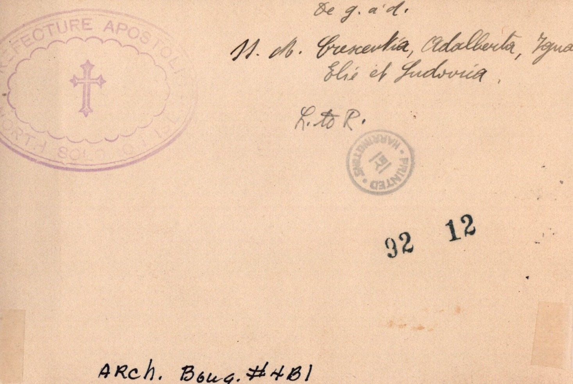
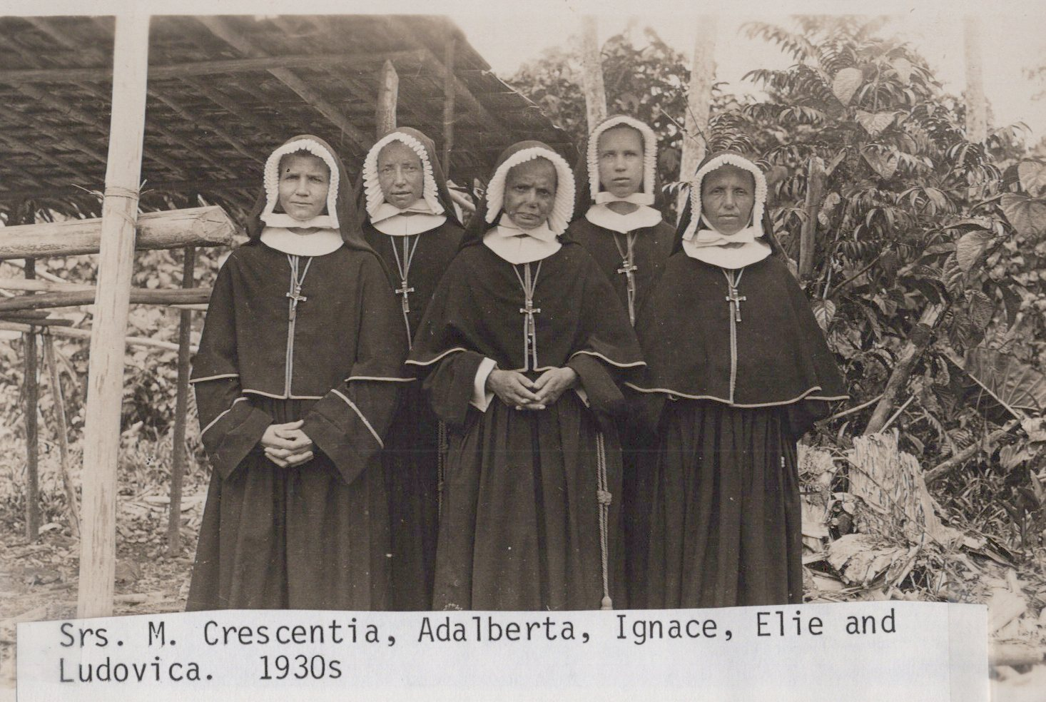
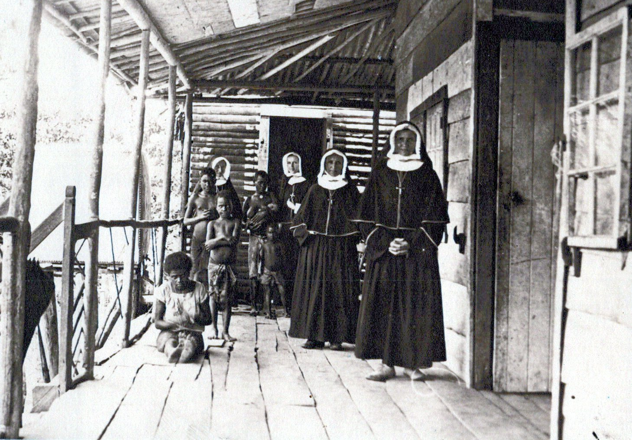
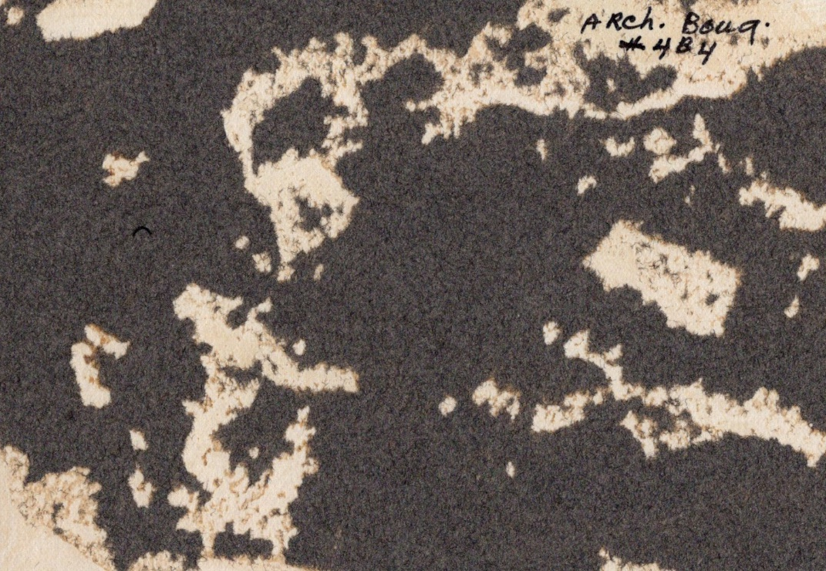
Above: Srs. Crescentia, Adelberta, Ignace, Elie and Ludovica. 1930s. Photograph
Above: Back, inscription, Srs. Crescentia, Adelberta, Ignace, Elie, and Ludovica, left to right. 1930s. Photograph.
Left: Sisters’ house in early days. Sr. M. Elie and Lidwina are among the sisters in the group. 1920-1930s. Photograph
Right: Back of image, Sisters’ house, no preserved inscription. 1920-30s. Photograph.

Slide 7
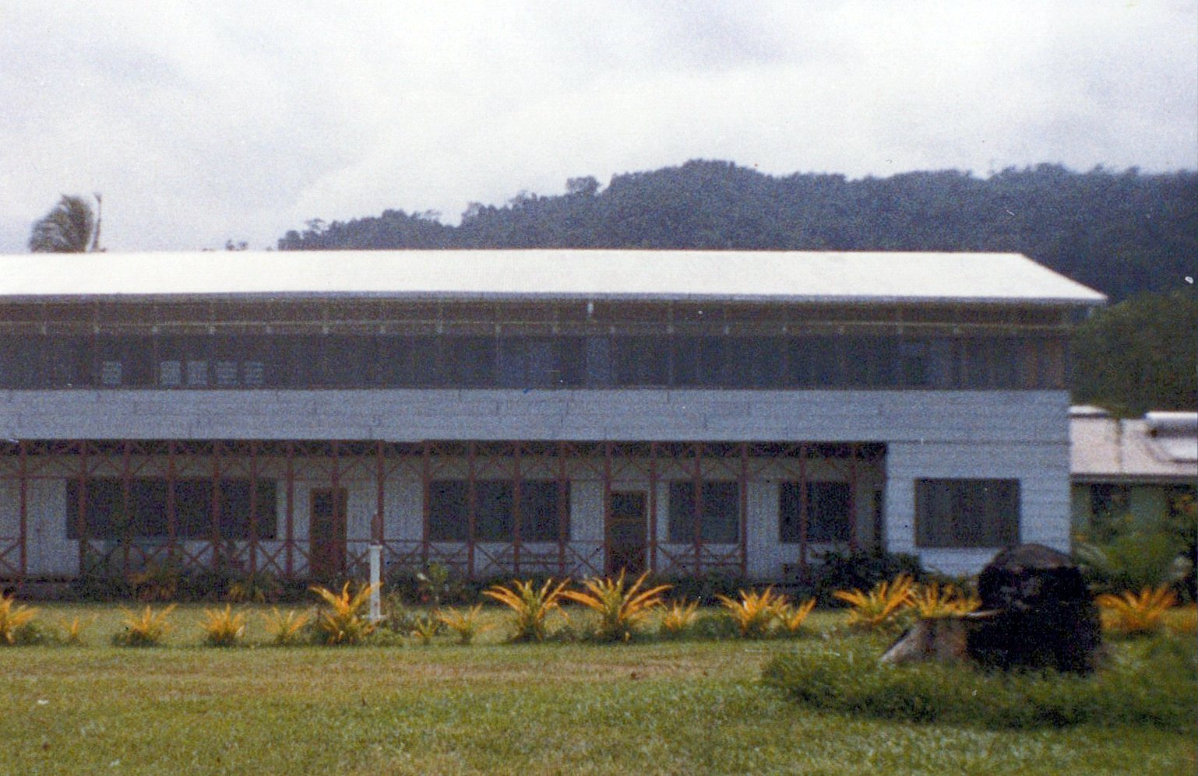
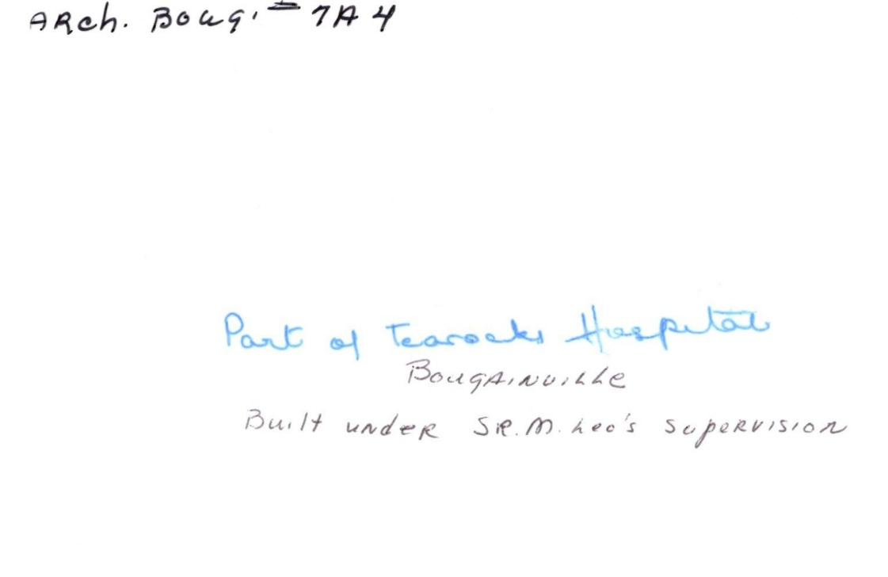
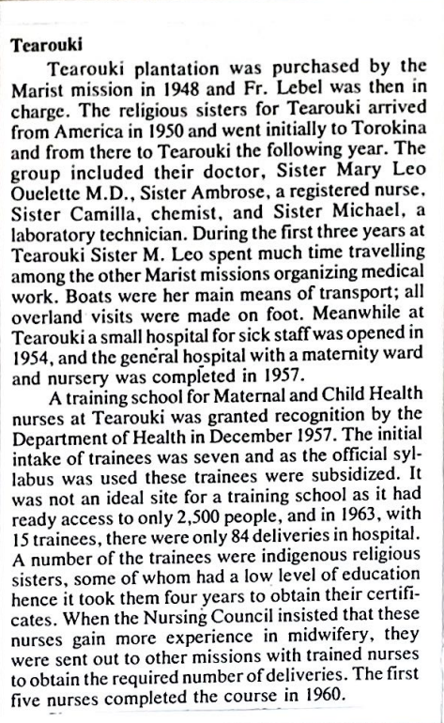
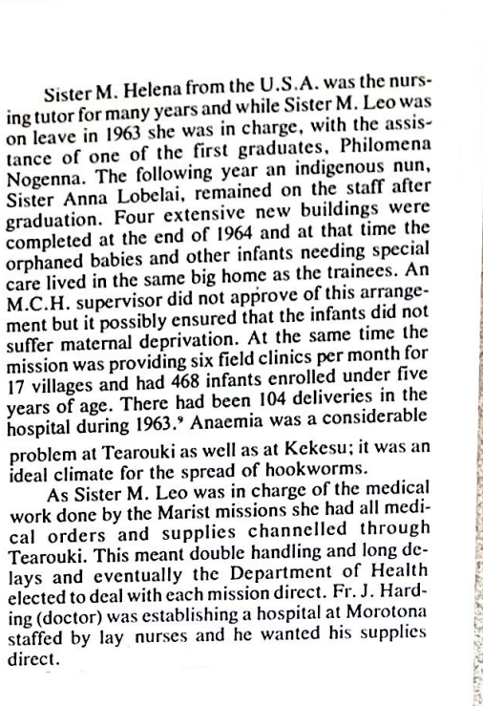
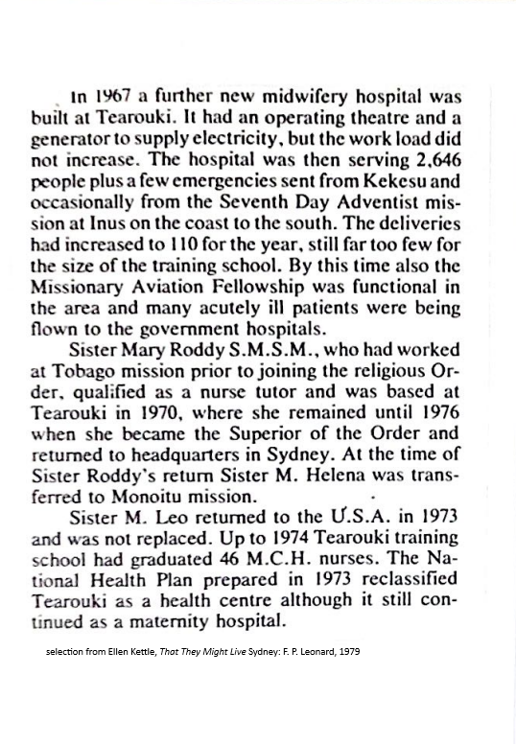
Above, left: Tearouki hospital, built under the supervision of Sr. M. Leo, SMSM, M.D.
Above, right: back, inscribed, Tearouki hospital
Left: Information on Tearouki hospital, selected from Ellen Kettle, That They Might Live Sydney: F. P. Leonard, 1979

Slide 8
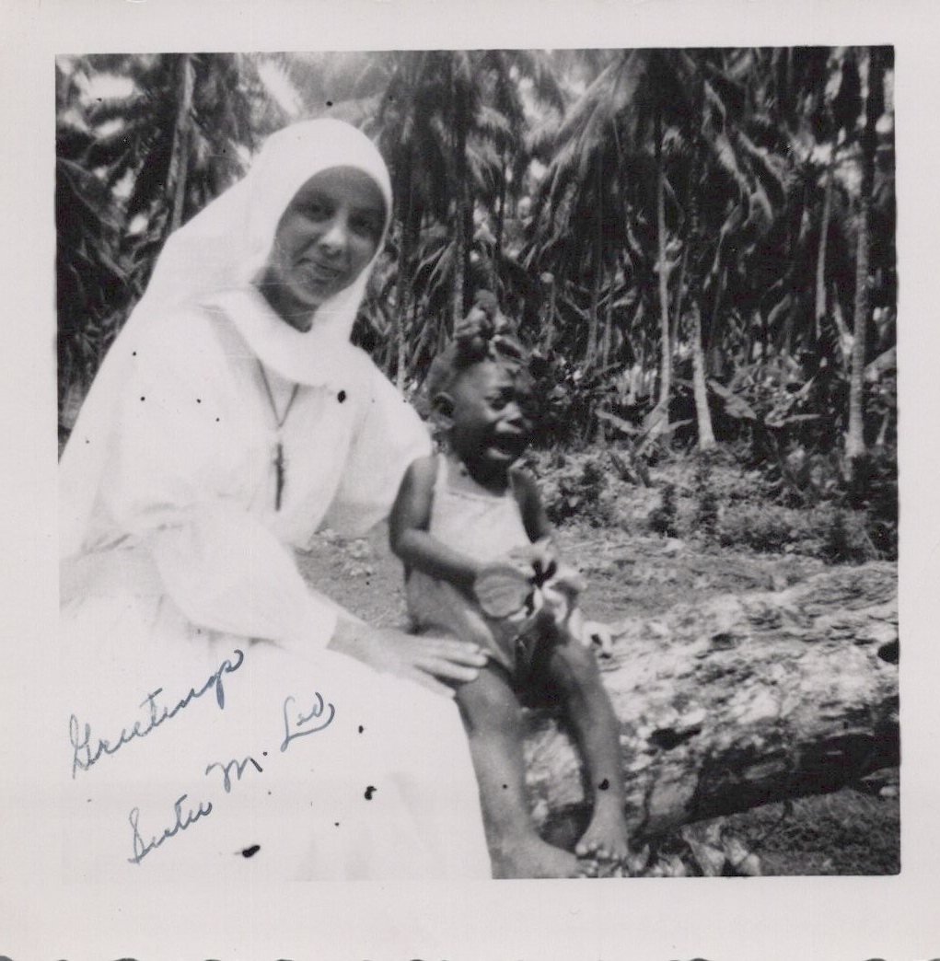
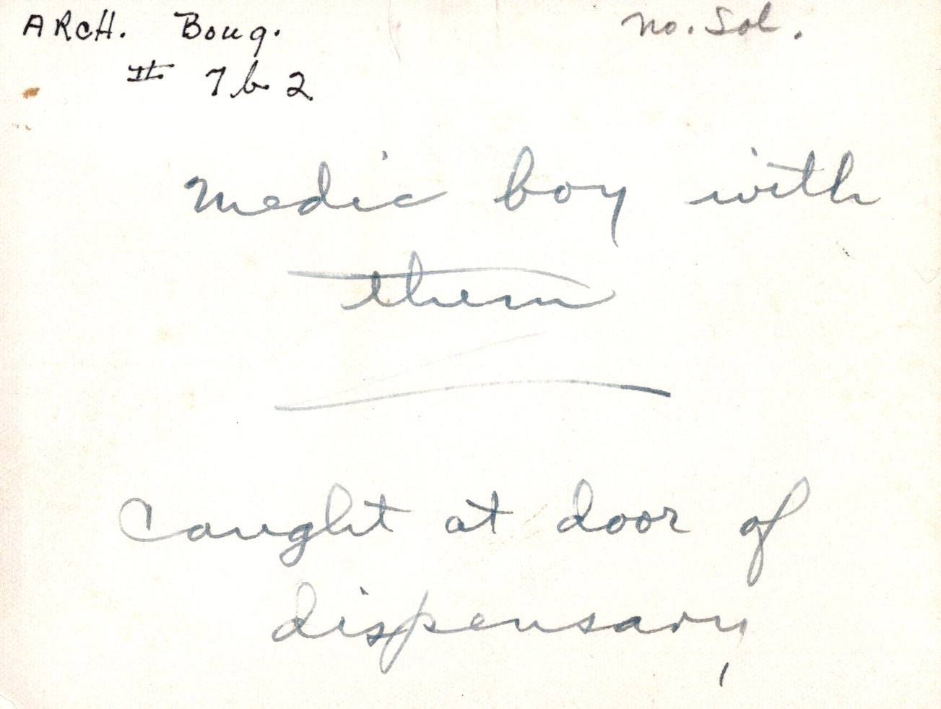
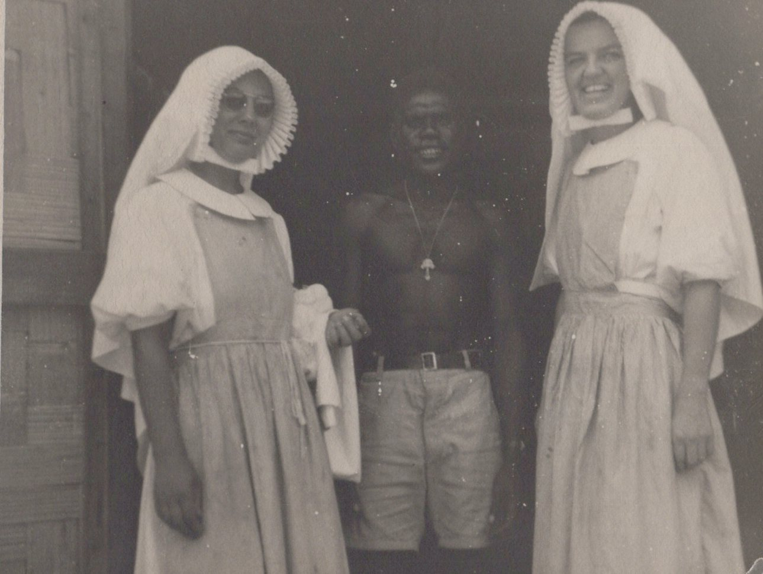
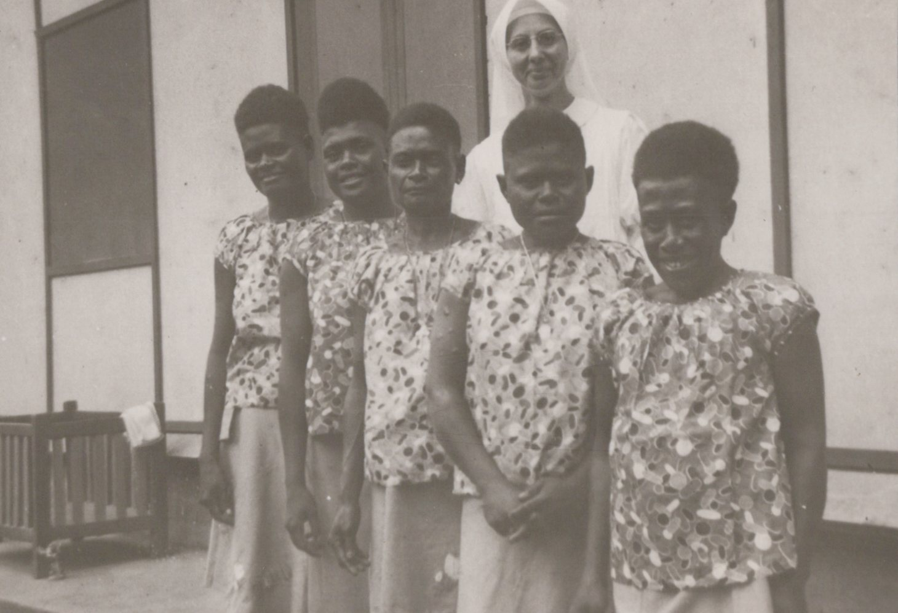
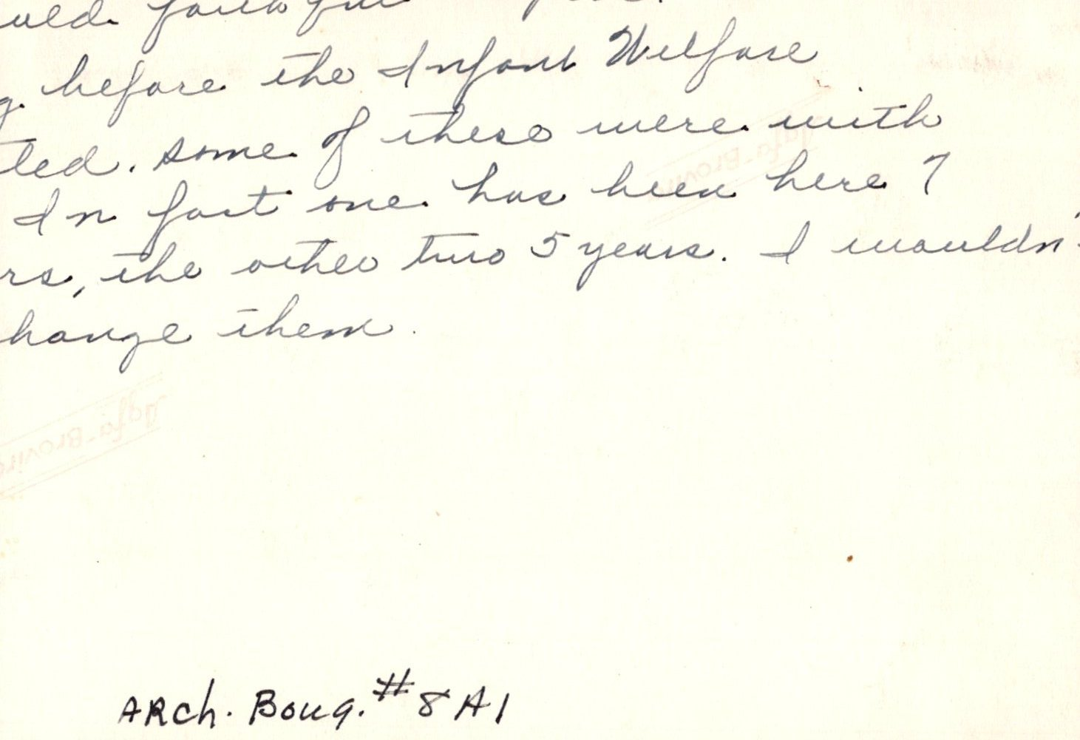
Below: Srs. Mary Leo and Ambrose with their Medic, Tearouki Health Center, 1950s. Photograph.
Below: back, inscription, Srs. Mary Leo and Ambrose with Medic, 1950s. Photograph.
Above: Sr. M. Leo, SMSM, M. D., Tearouki hospital. Photograph.
Far left: Women working in Infant Welfare, Tearouki Health Centre. Photograph.
Left: Back, inscription (cut off in parts), Women working in Infant Welfare, Tearouki Health Centre. Photograph.

Slide 9
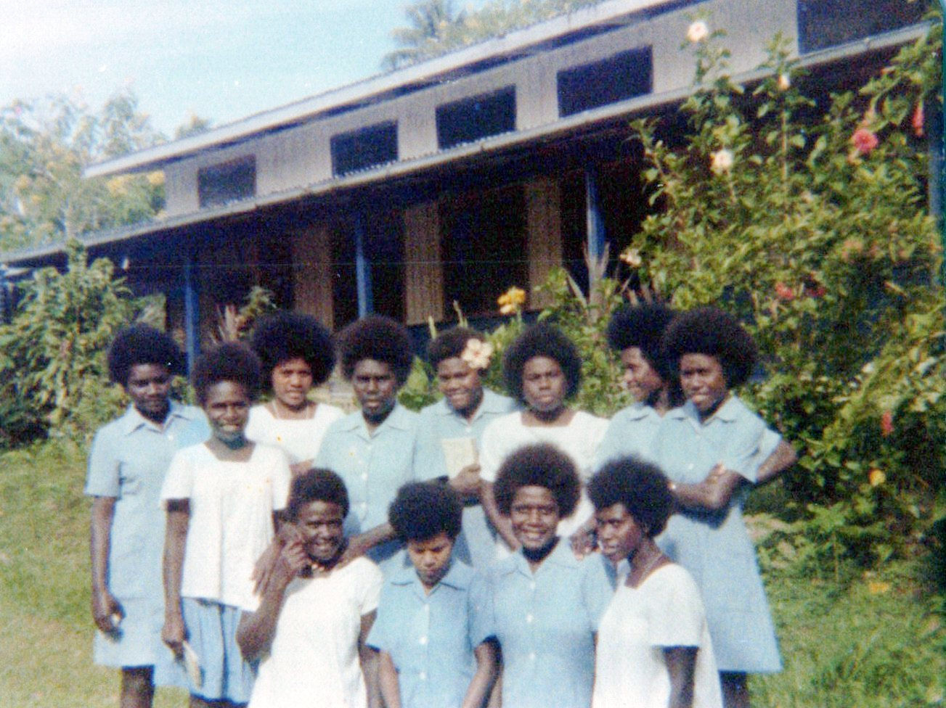
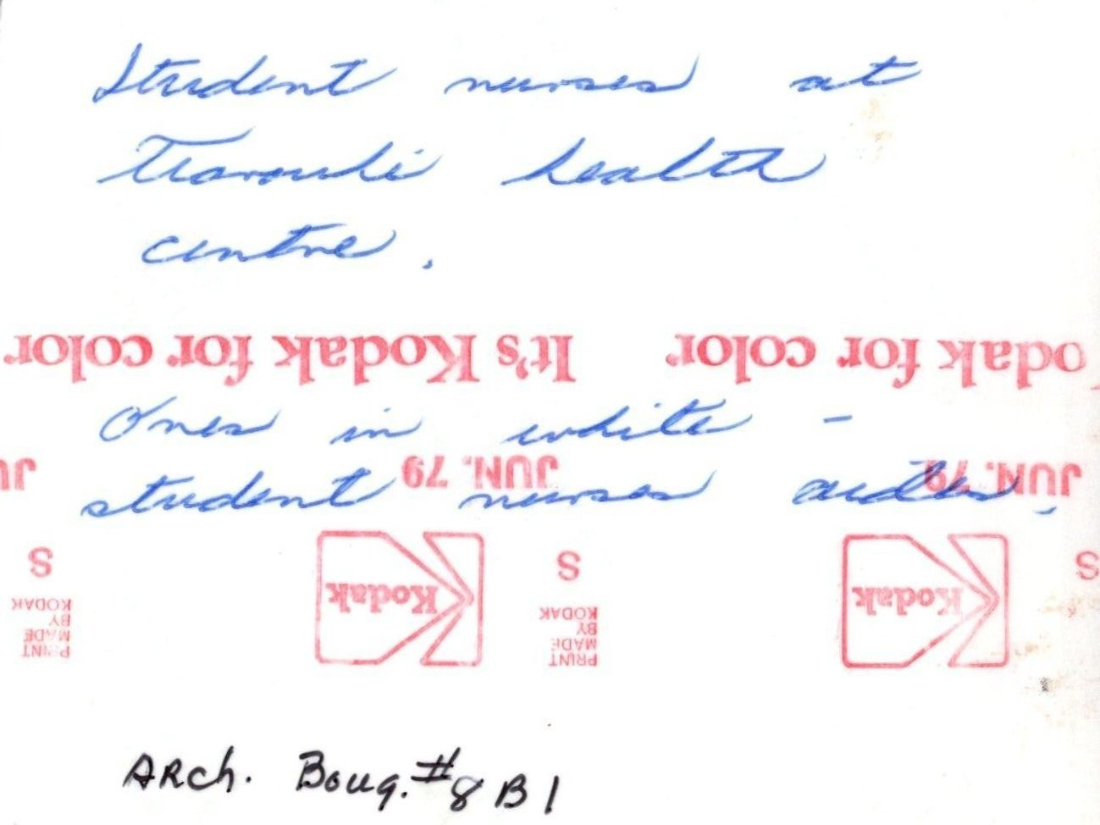
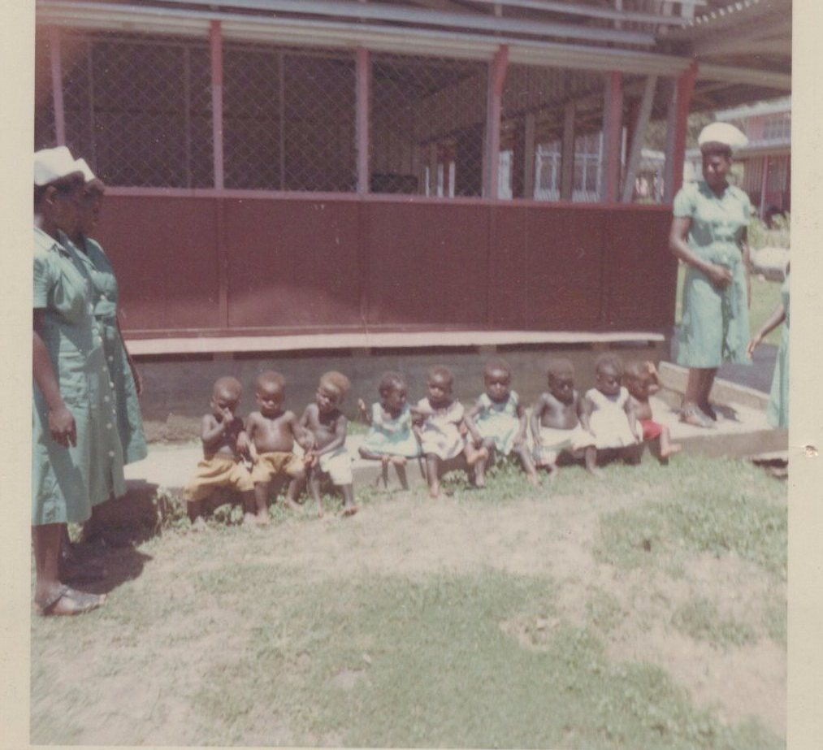
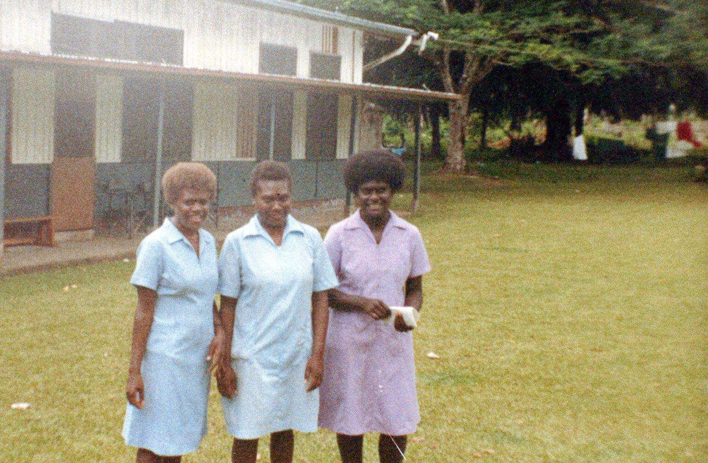
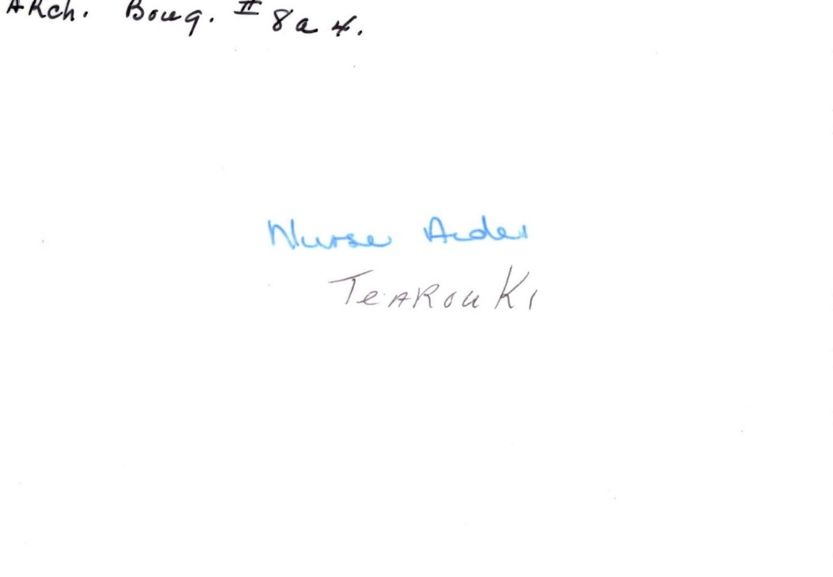
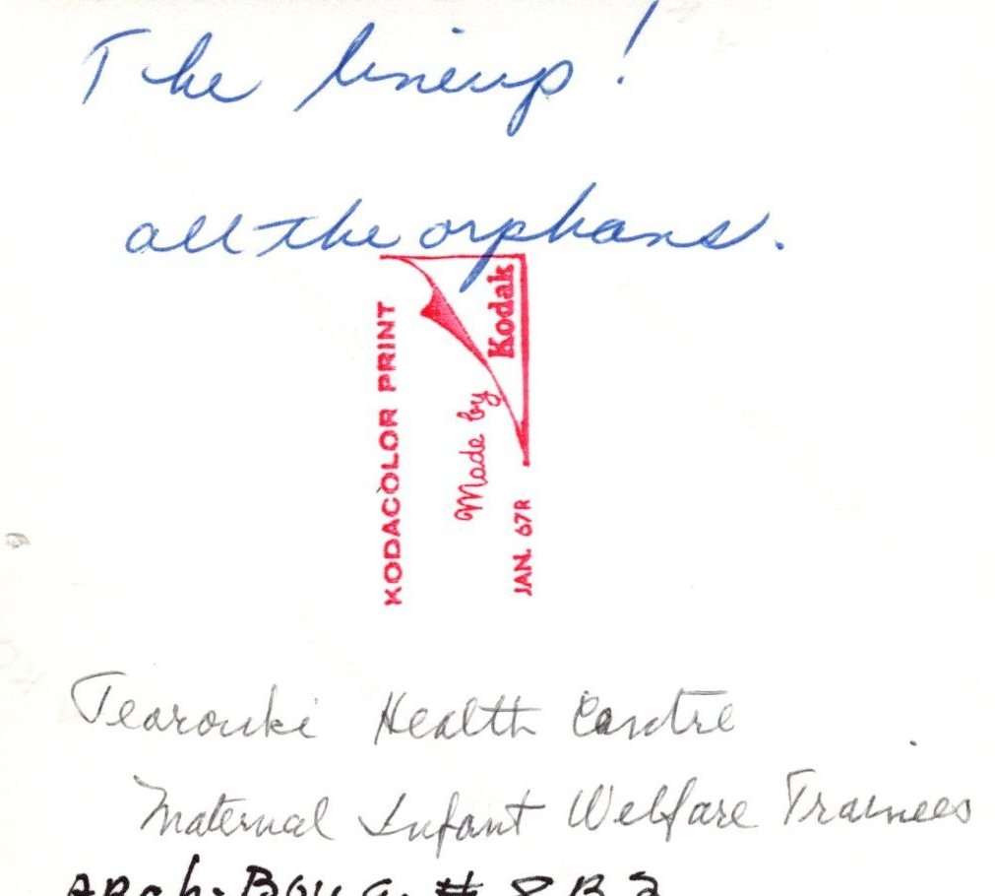
Above, right: Maternal Infant Welfare Trainees, Tearouki Health Centre and the “line up” of orphans there, 1960s. Photograph.
Below, right: Back, inscription, Maternal Infant Welfare Trainees, Tearouki Health Centre and the “line up” of orphans there, 1960s. Photograph.
Above, left: Student nurses at Tearouki Health centre. In white are student nurses’ aides. 1960s. Photograph
Below, left: Nurses’ aides at Tearouki, 1960s. Photograph.
Above, center: Back, inscription, Student nurses and nurses’ aides at Tearouki Health Centre. 1960s. Photograph.
Below, center: Back, inscription, Nurses’ aides at Tearouki, 1960s. Photograph.

Slide 10
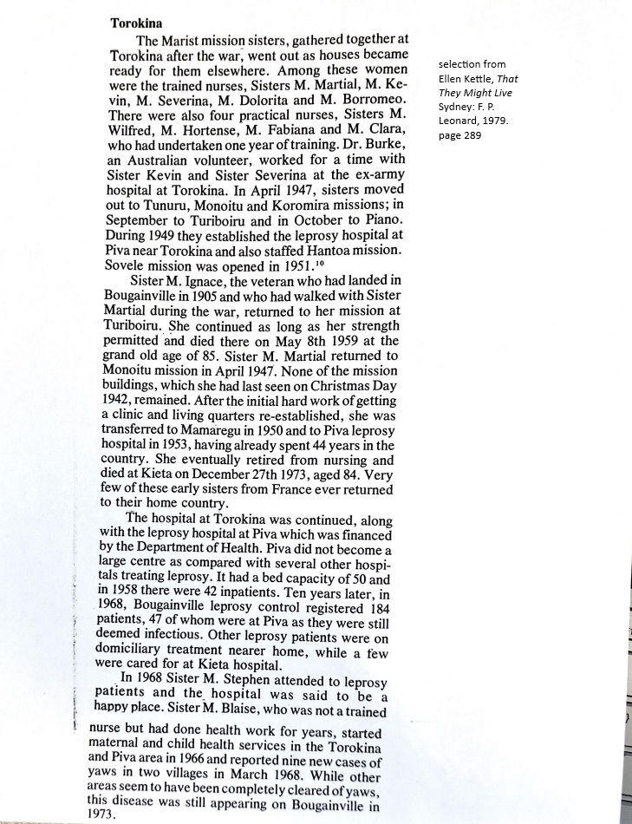
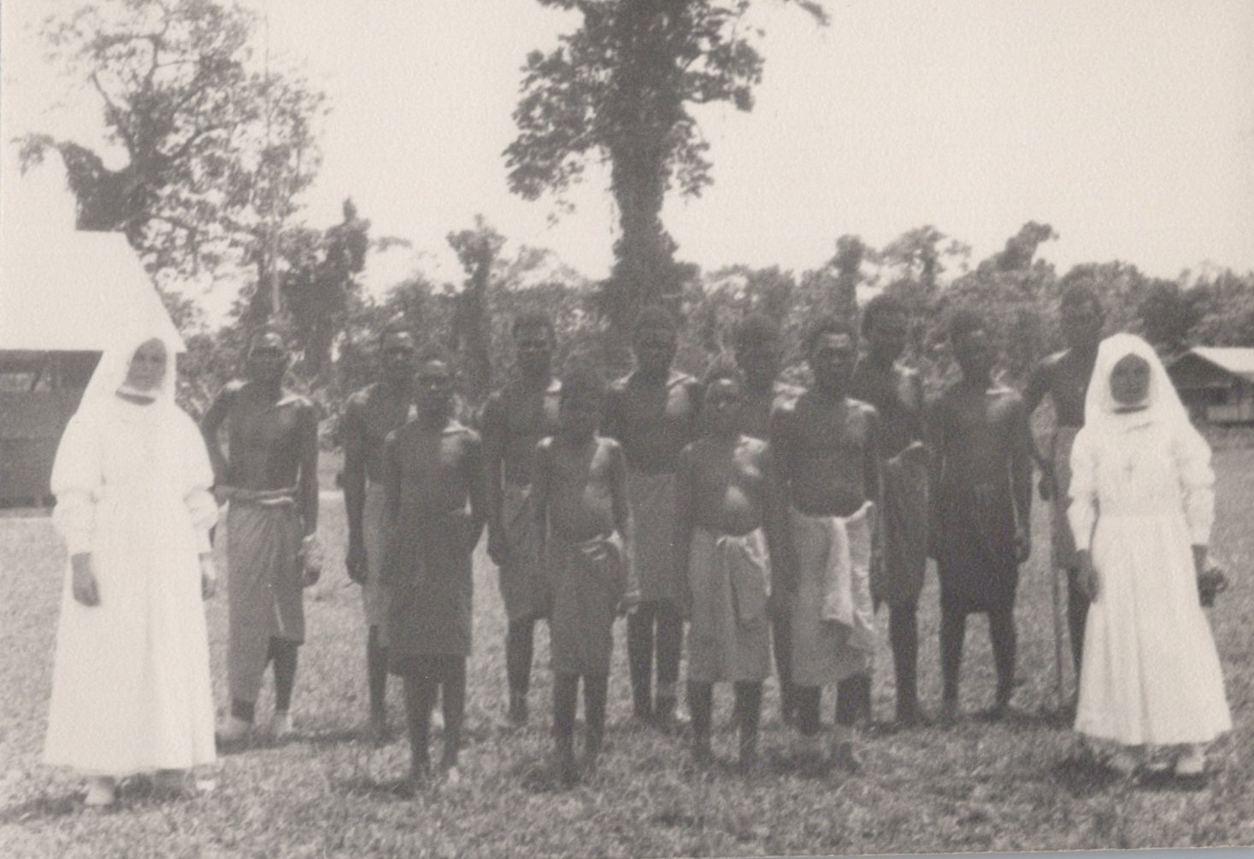
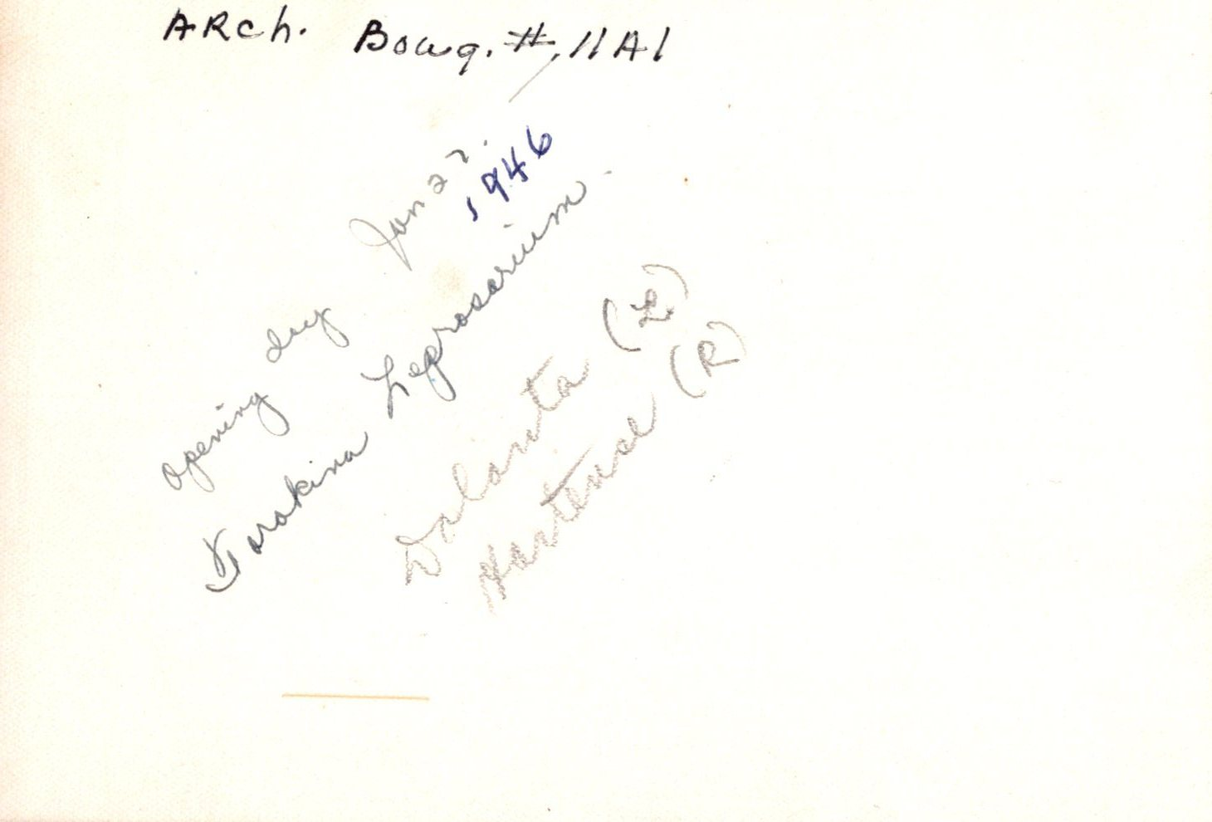
Left: Reproduced selection from Ellen Kettle, That They Might Live Sydney F.P. Leonard, 1979, page 289. Focused on Torokina hospital and Piva leprosarium, Bougainville.
Above, right: Opening of leprosarium at Torokina (Piva): January 27, 1946, with Srs. M. Dolorita and Hortense, SMSM. Photograph.
Right: Back, inscription, Opening of leprosarium at Torokina (Piva): January 27, 1946, with Srs. M. Dolorita and Hortense, SMSM. Photograph.

Slide 11
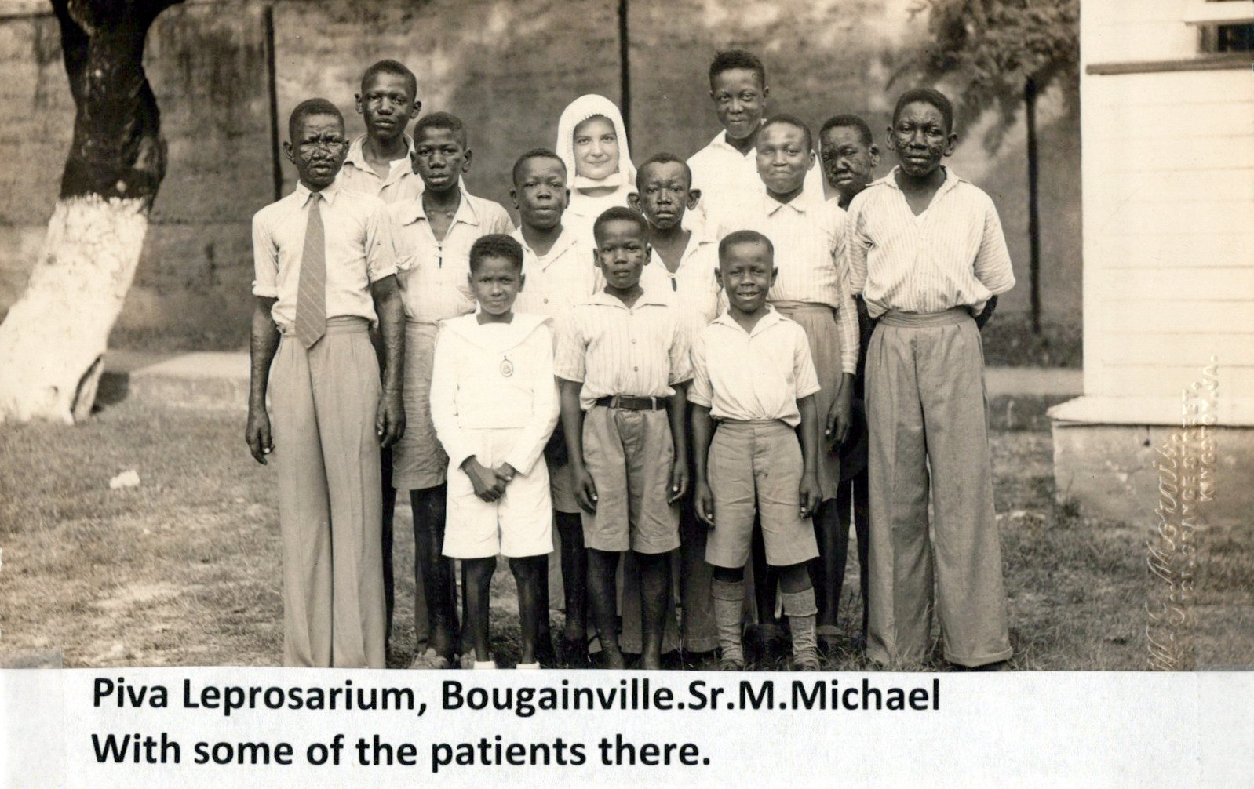
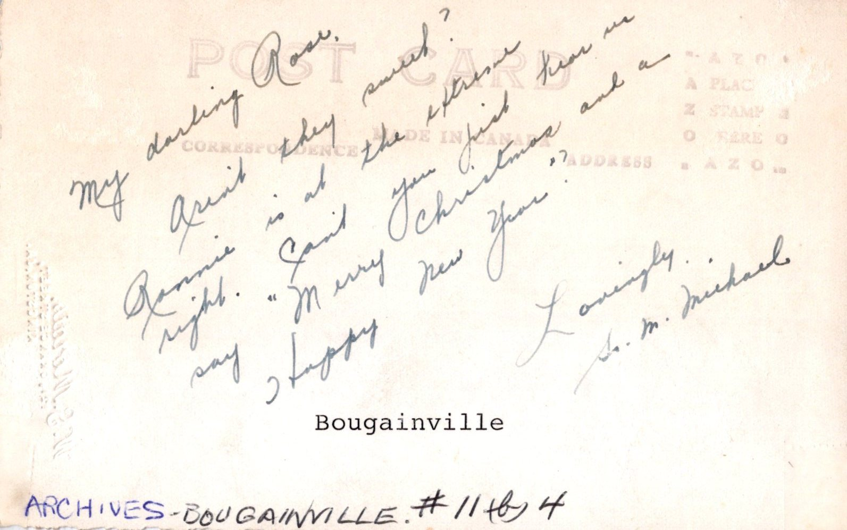
Below: Back, inscription (authored by Sr. M. Michael), Opening of leprosarium at Torokina (Piva): January 27, 1946, with Srs. M. Dolorita and Hortense, SMSM. Photograph
Above: Piva Leprosarium, Bougainville. Sr. M. Michael and patients. Photograph.

Slide 12
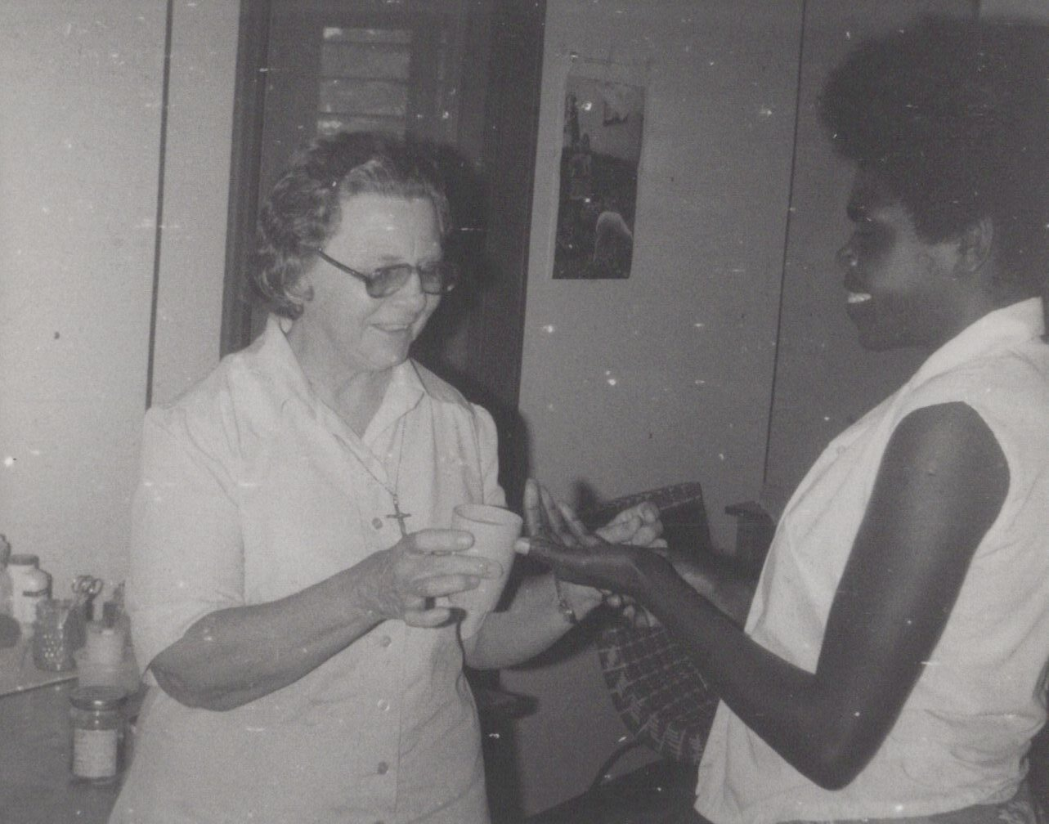
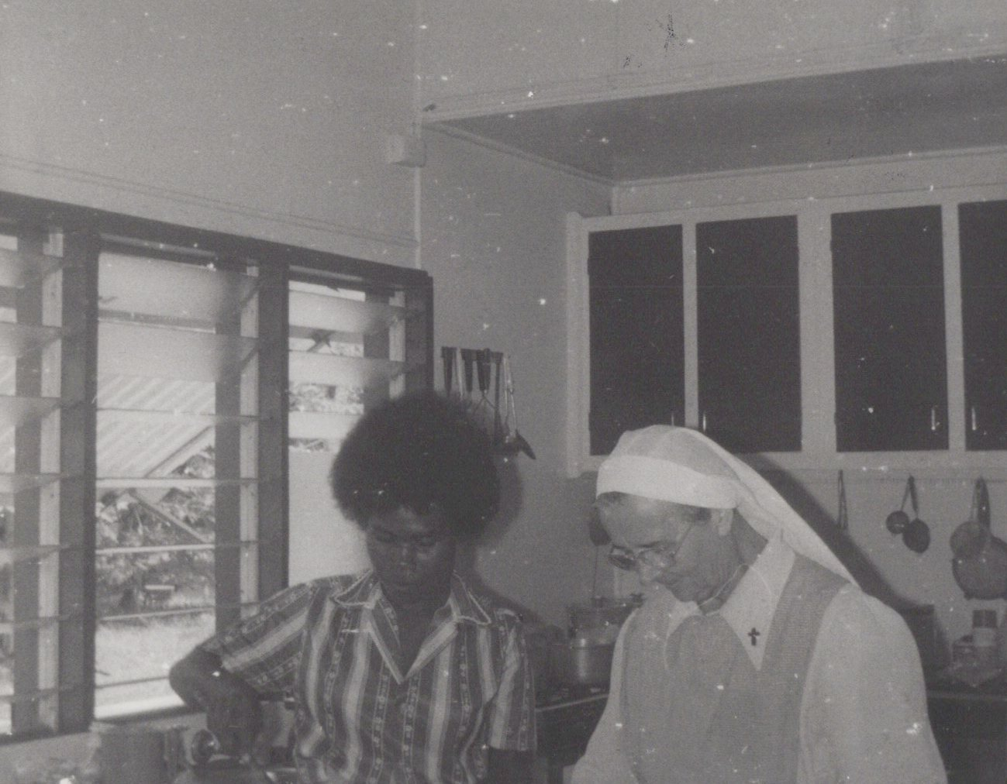
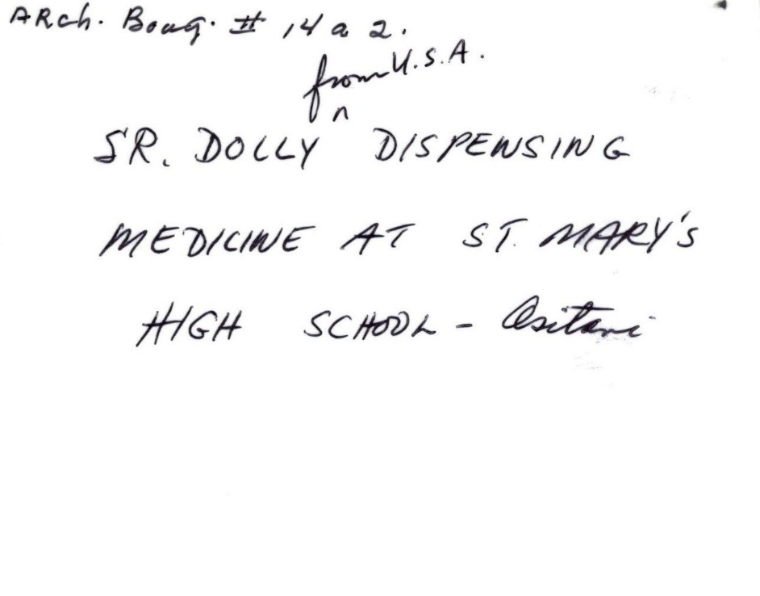
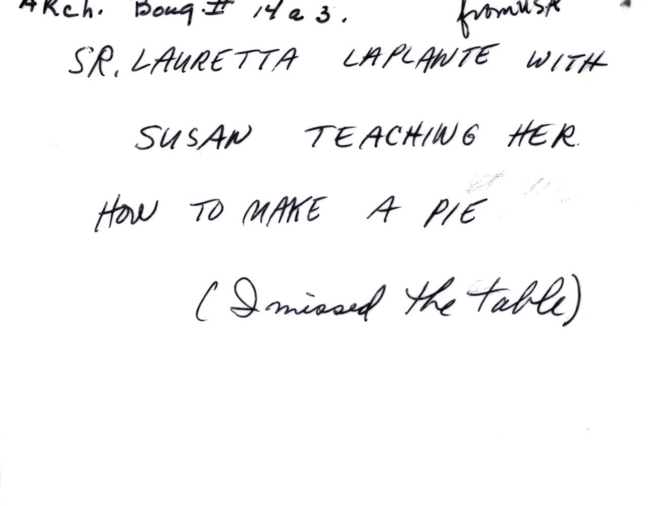
Left: Sr. Lauretta Plant (from U.S.A.) teaching cooking to one of the women. St. Mary’s High School, Asitavi, Bougainville. Photograph
Below: Back of image, inscribed
Above: Sr. Mary Dolorita (from U.S.A.) dispensing medicine to a student at St. Mary’s. St. Mary’s High School, Asitavi, Bougainville. Photograph
Below: Back of image, inscribed

Slide 13
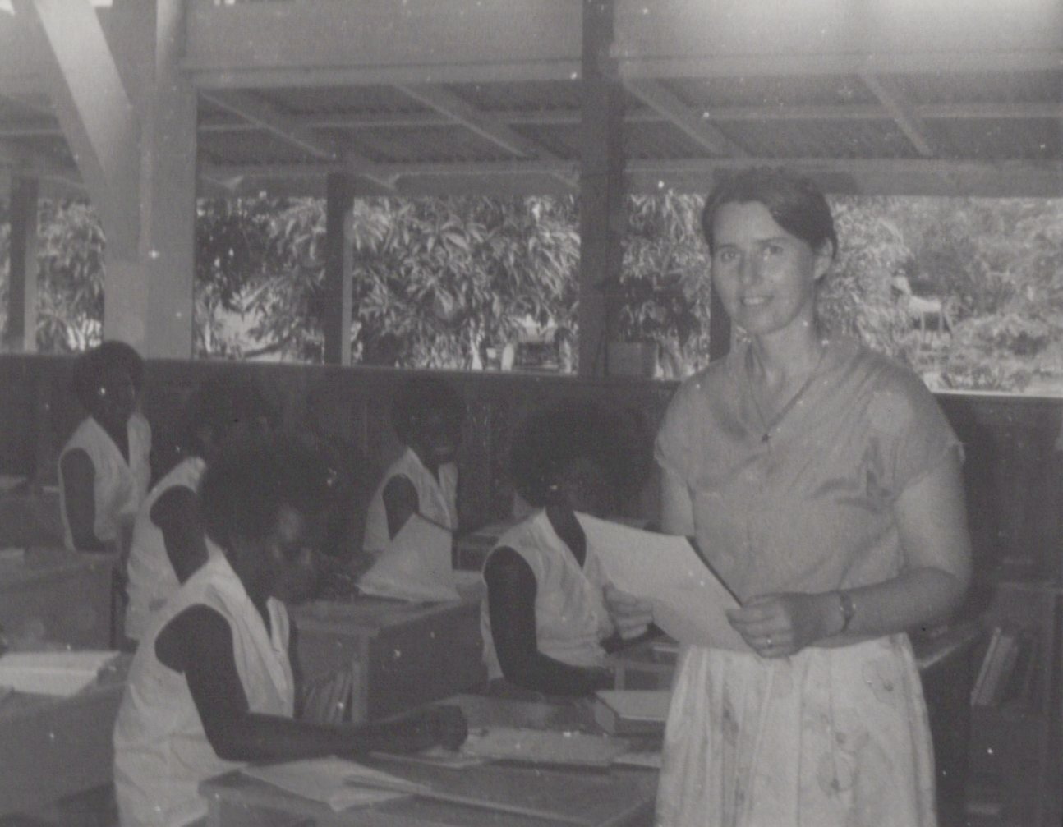
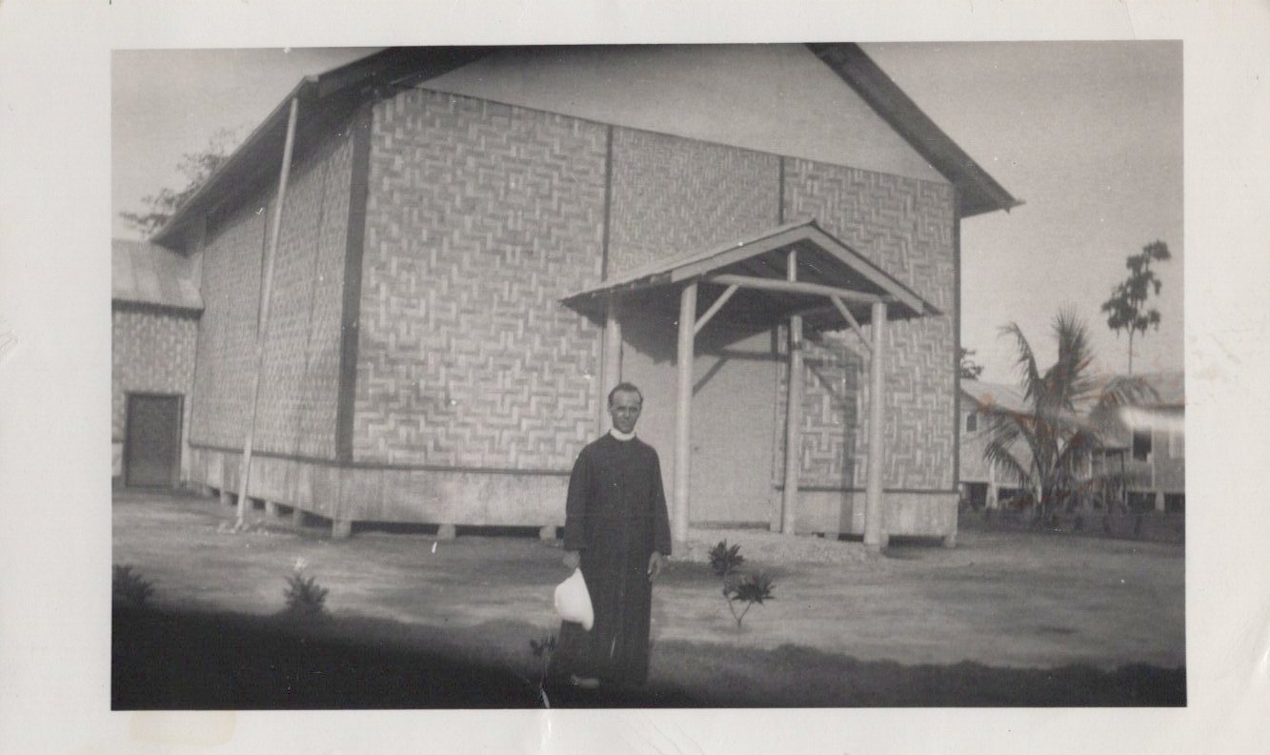


Left: Fr. Albert Lebel, S. M. (from Brunswick, Maine) at St. Mary’s High School, Asitavi, 1930s. The building is his church; rectory is to the right). Photograph
Below: Back of image, inscribed
Above: Sr. Denise McMahon (from Australia) in classroom. St. Mary’s High School, Asitavi, Bougainville. Photograph
Right: Back of image, inscribed.

Slide 14




Left: Father Emmet McHardy, from New Zealand, taken at Tunuru Station, Bougainville, 1930. Postcard.
Below: Back of image, inscribed, “Le Pere McHardy, notre confrere Neu Zelandais”
Above: Church at Tunuru Station, Bougainville, under Father Emmet McHardy, 1930. Postcard
Below: Back of image, inscribed

Slide 15




Above: Arawa Government General Hospital. Bougainville, Photograph
Below: Back of image, inscribed, Sr. Frances Dunn, Tutor, Government Hospital, Bougainville, Arawa Hospital, Photograph
Above: Srs. Matthias and Martial with school girls at Timbutz, 1920s. Photograph
Below: Back of image, inscribed: “Soeurs M. Matthias et Martial, les filles de Timbutz”
Above: Sisters’ house at Timbutz, 1920s-1930s. Photograph
Below: Back of image, inscribed: “N. Solomons, Timbutz, Srs. House.”

Slide 16
Left: Srs. M. Placid and Camille at Koromira Mission, Bouganville, 1940s. Photograph.
Below: back of image, inscribed: “(old habit)” and “Koromira Soeurs Placid et M. Camille/Sr. Mary Placid Sr. Mary Camille.”
Above: Koromira Catholic Mission, Bougainville, N.S. 1950s. Photograph.
Below: Back of image, inscribed: “Koromira Mission where Sr. M. Blaise is stationed, Koromira, Bougainville, North Solomon Islands.”

Slide 17

Above: back row, Srs. M. Ambrose and Henriette; front row: CSN Srs. M. Louise, Rosa, and an unidentified sister. Hantoa, June 1955. Photograph
Below: Back of image, inscribed: “Nama Community June 1955; Henriette, Ambrose, CSN: Louise, Rosa, ?”
Above: In front of Hantoa Church, Bougainville: Srs. M. Emilienne and Immaculae, a St. Joseph Sister and Bishop Wade. CSN (Congregation of the Sisters of Nazareth) Sisters not identified. Postcard
Below: Back of image, inscribed
Above, Hantoa Church, children in foreground, 1950s. Photograph
Below, left: Back of image, inscribed: “This is our Church! The poor Lord! When it rains, everything is soaking. When there’s a strong wind, everything is under a thick layer of dust! Ah, wail till we get our new Cathedral!”

Slide 18

Above: Sr. Maria of the Sacred Heart SMSM (from England) and Sr. M. Thomas CSN (Congregation of the Sisters of Nazareth), Hantoa, Bougainville, North Solomon Islands, 1955. Photograph
Below: Back of image, inscribed.
Above: Father Leo Lemay before he was consecrated Bishop in the 1960s. Photograph
Below: Back of image, inscribed: “Trying to smile I guess!”
Above: Father Leo Lemay with seminarians at Torokina, 1950s. Photograph
Below: Back of image, inscribed: “A study in faces.”
Above: Bishop Wade when first consecrated, 1930s.
Photograph
Below: Back of image, inscribed, North Solomons

Slide 19
Above: CSN (Congregation of the Sisters of Nazareth) Sisters: M. Bernadette, Celine, Elisabeth, Bernadette, Patricia, Sophie at the grave of Sr. M. Crescentia, SMSM. All Souls’ Day, 1991. Photograph.
Right: Back of image, inscribed.

Slide 20
Above: Moratona Station, Bougainville, North Solomon Islands. Left: schoolhouse; larger house center-right is the Sisters’ house; right: girls’ dormitory. 1950s. The river flooded its bank a few years later and destroyed the station. It was later rebuilt much further from the river. Photograph.
Right: Back of image inscribed with corresponding building identifiers: dormitory, Sisters’ house, schoolhouse.

Slide 21

Left: Father Jim Moore showing the expanse of a flying fox’s wings. Photograph.
Below: Back of image, inscribed.
Above: St. Joseph Mission Ship, Bougainville, North Solomon Islands. 1950s. Photograph.
Below: Back of image, inscribed: “St. Joseph Mission Ship, N. Sol./12 bunks/St. Jos U.S. Army Hospital PT for picking up patients.”

Slide 22


Left: Asitavi Village Church, Bougainville, North Solomon Islands, 1940s. Photograph
Below: Back of image, inscription: “Village Church [old] Asitavi, destroyed”

Slide 23


Left: Father Jim Moore administering baptism inside the station church, 1950s. Photograph
Below: Back of image, inscribed

Slide 24

Above: Church at Tabago, Bougainville, North Solomon Islands. 1970s. Photograph.

Slide 25


Above: Sr. M. Barbara, Father Henry Fluet SM, Sr. M. Fabian, Bougainville, 1950s. Photograph.
Above: Back of image, inscribed

Slide 26


Above: Sr. M. Fabian supervising sewing lessons to Pari, houseboy’s wife. Background: plaited bamboo wall. Bougainville, 1950s. Photograph.
Above: Back of image, inscribed: “Sr. M. Fabian/Pari houseboy’s wife”

Slide 27


Above: Sr. M. Helena, with triplets she helped to deliver. Tearouki, Bougainville, 1950s. Photograph
Above: Back of image, no additional inscription

Slide 28


Below: Back of image, inscription: “…[cut off] orphans with me, outside the nursery. Leo”
Above: Sr. M. Leo, MD, SMSM, medical doctor, originally from Chisholm, Maine. Supervised the building of her own hospital, and later developed a Maternal Child Health Programme formally recognized by the government of Papua New Guinea. Bougainville, 1950s. Photograph.

Slide 29

Left: Father Jim Moore’s “boys” cutting trees for timber for building up the mission station at Moratona, Bougainville. 1950s. Photograph. No additional inscription on back of image.

Slide 30


Above: Building galvanized rainwater tanks for gathering drinking water at the mission station. Bougainville, 1950s. Photograph credited to the United Nations (UN 46552), 1955.
Above, right: Back of image, reproduced text:
“TRUST TERRITORY OF NEW GUINEA (BACKGROUND PHOTOGRAPH)
UN 46552 RABAUL (NEW GUINEA), 1955-
In the Trust Territory of New Guinea, administered by Australia, the educational system includes schools operated by the Administration, the Missions and the Native Village Councils. Education is free at all stages in both the Administration and Mission schools, and compulsory attendance is in force in certain areas. One of the main institutions providing for the technical training of natives is the Rabaul Technical Training School, where students learn plumbing, carpentry, metal work, etc.
This photograph shows a group of trainees at the Rabaul Training School working with sheet metal which they are using to build water tanks.
Please credit: UNITED NATIONS.”

Slide 31


Left: Sr. M. Melita (Sr. Frances Dunn), originally from New Jersey, nursing. 1950s. Photograph.
Below: Back of image, inscribed: “S.M. Melita doing what she does best—nursing! (N.J.) (Sr. Frances Dunn)
Ownership of original image attributed to Rev. James J. Moore, Moratona, Bougainville, Territory of New Guinea (see stamp) and to Marist Missionary Sisters.

Slide 32


Left: Father Aloysius Tamuka, first Bougainvillean priest to be ordained, blessing Sr. M. Ignace, SMSM, the foundress of the local Sisters known as the Congregation of the Sisters of Nazareth (CSN). Church at Muguai, Bougainville, 1953. Photograph.
Below: Back of image, inscribed: “return to Sr. M. Augustine [presumed original owner of image], Marist Missionary Sisters, 863 Central Street, Framingham Centre, Mass.”

Slide 33


Below: Back of image, inscription and notes
Above: Father Miltrup, SM and Sr. Maria of the Sacred Heart, SMSM (originally from England), with school boys in Buin, Bougainville, North Solomon Islands. 1950s. Photograph.

Slide 34


Below: Back of image, inscription and labels: “Moratona, No. Sol., Water Scene” and ownership of image attributed to Sr. M. Augustine and Marist Missionary Sisters, 863 Central Street, Framingham Centre, Massachusetts.
Above: Children playing in a North Solomonese brook. Moratona, Bougainville, 1950s. Photograph.

Slide 35


Below: back of image, inscribed: “Roll 8/ S.M. Michael, Piva”
Above: Sr. Mary Michael with patients, Piva Leprosarium near Torokina, Bougainville, 1950s. Photograph.

Slide 36



Above, left: An unidentified SMSM shopping at Justin Szeto’s store, Chinatown, Kieta, Bougainville. Woman on left in image: Helen Szeto, wife of store-owner. 1950s. Photograph.
Above, right: Fr. Clemens, SM. at Justin Szeto’s store, Chinatown, Kieta, Bougainville. Woman on left in image: Helen Szeto, wife of store-owner. 1950s. Photograph.
Left: Back of above-left image, inscribed.

Slide 37


Below: Back of image, inscription: “Mission Boat: ‘St. John’”
Above: The St. John: Bishop’s launch used for cargo delivery, mail, and transport for Bishop and Sisters from one station to another. North Solomon Islands, 1950s.

Slide 38






Above, center: Bishop Wade with Solomonese priests, sisters, and brothers. Bougainville, 1950s. Photograph.
Above: Srs. Emilienne and Gisele with the Professed at Hantoa, Bougainville, February 2, 1953. Background right: Sisters’ house; Background left: Girls’ house. Photograph.
Below: Back of image, inscribed
Above: Back row, First Three CSN (Congregation of the Sisters of Nazareth) Sisters: M. Denise, Josephina, and Therese. Front row: Sr. M. Mathias, Bishop Wade, Sr. M. Ignace. Bougainville. Photograph.
Right: Back of image, inscribed.
Left: Back of above-center image, inscribed: “We, Solomonese priests, sisters and brothers join with our Bishop in seding our very best wishes for Christmas and the New Year to you, all the Sisters, novices, and postulants and especially to Srs. Mary Fabian and Ambrose!”

Slide 39






Above: Sr. M. Claire (novice) with her nephew, 1950s. Bougainville. Photograph.
Below: Back of image, inscribed
Above: Bishop Leo Lemay with two professed CSN (Congregation of the Sisters of Nazareth) Sisters and novices, 1967. Bougainville. Photograph.
Below: Back of image, typed label.
Above: The exterior of St. Theresa’s chapel at Chabai. To the right: the former SMSM convent, demolished shortly after this photograph was taken. 1960s. Bougainville. Photograph.
Below: Back of image, typed label

Slide 40




Above: Meeting of two local congregations—CSN from Chabai, Bougainville, and Sr. M. Donasiana, DMI (Daughters of Mary Immaculate) Vutulaka, Northwest Guadalcanal, Solomon Islands.
Below: Back of image, typed label affixed.
Above: CSNs working at Tearouki, Bougainville: Srs. M. Leona, Francis, Catherine and Savio, 1950s, Photograph.
Below: Back of image, inscribed: names of individual CSN sisters, and notes—”Native Sisters” and “These are not prewar photos.”

Slide 41


Far left: Srs. Clara and Christine, CSN, Bougainville. Photograph
Left: Back of image, inscribed: notes—”Solomonese,” “N. Sol., Native Srs, Srs. M. Clara and Christine” “Crop as marked”

Slide 42


Left: Father Dionne, SM (from Canada), founder of the Little Brothers of St. Joseph. Bougainville, Photograph.
Below: Back of image, inscribed: “No. Sol. Fr. Dionne, S.M. (Canada) founder of ‘Little Bros of St. Jos’”

Slide 43





Left: Bishop Thomas J. Wade, S.M., Bishop of Bougainville. Postcard
Below: Back of image, typed label
Above, left: Bishop Thomas J. Wade, SM, Bishop of Bougainville. Photograph
Above, right: Back of image, inscribed “Souvenirs” with typed label
Right: Typed note found affixed to the back of this photograph

Slide 44



Left: Bishop Leo Lemay, SM. Consecrated Bishop to replace Bishop Wade, SM, in Bougainville, North Solomons. 1960s. Photograph.
Above: Bishop Gregory Singkai, Bishop of Bougainville, with Pope John Paul II, Rome 1979. Photograph
Right: Back of image, inscription

Slide 45


Left: Sr. Catherine Keogh with a CSN (Congregation of the Sisters of Nazareth) Sister, ironing with “charcoal irons,” Bougainville, 1960s.
Photograph.
Below: Back of image, original ownership attributed to Reverend James J. Moore, SM, Moratona, Bougainville, Territory of New Guinea.

Slide 46


Left: Cardinal N. T. Gilroy (from Sydney) with Little Brothers of St. Joseph, 1950s, Bougainville. Photograph.
Below: back of image, inscribed

Slide 47



Above, right, far right: Father James Moore, SM, and friends, Bougainville. Photographs. (backs of images not inscribed)

Slide 48




Right: Monoitu Health Center, Bougainville with nurse, Sr. M. Melita (Sr. Frances Dunn) SMSM. 1963. Photograh donated to archives by Sr. Frances Dunn, SMSM
Left: Bougainville Wharf at Tsiroge, Bougainville; background, Taiof Island. Foreground left to right: The St. Theresa, The St. Joseph, The St. Charles. Postcard donated to archives by Sr. Frances Dunn, SMSM
Right: Back of image, inscribed: “New Hospital Monoitu Health Center, around 1963 Nurse Sr. Fran Dunn (Sr. M. Melita)”
Left: Back of image, inscribed: “Wharf at Tsiroge—looking across at Taiof Island” “Do you remember?’ [different ink and penmanship] “L-R The St. Theresa, The St. Joseph, and The St. Charles”

Slide 49



Top left, bottom left, center right: images from the Feast of Our Lady Celebration, Bougainville, Papua New Guinea. Photographs (no inscriptions on backs of images)

Slide 50




Above: Sr. M. Juliana Roper SMSM, from her departure ceremony, Bougainville, Papua New Guinea, 1984. Photograph. Ownership attributed to Sr. M. Juliana Roper.
Below: Back of image, inscribed: “Julie Bougainville 1988 at my departure ceremony given by the people, two of my very good friends and my ‘farewell’ cake’”
Above: Sr. M. Juliana Roper, proxy godmother to an Australian friend’s baby; Fr. Gerard Pelletier SM (deceased), Tunuru, Bougainville, May 7, 1988. Photograph. Ownership attributed to Sr. M. Juliana Roper.
Below: Back of image, inscribed: “Bougainville 1988 I am proxy god-mother for an Australian friend’s baby. Fr. Gerard Pelletier SM (since deceased)”

Slide 51



Top left: Retreat, Tunuru, Bougainville. Pictured, left to right: Srs. Kathleen, M. Juliana, Mary Kenny, Margarete, Micaheline, Borromeo, Lawrence, Gisele, Michael, M. Joan, Immaculae. Photograph. Ownership attributed to Sr. M. Juliana Roper
Below left: Back of image, inscribed: “Get-together—maybe a retreat in Bougainville; Tunuru or Kieta.”
Above: Sr. M. Juliana Roper and Sr. M. Lawrence (Rita Edge), Bougainville, Papua New Guinea. Photograph. Ownership attributed to Sr. M. Juliana Roper [no inscription on back of image]

Slide 52






Above: 100th Anniversary of Bougainville’s Evangelization. Celebration at Tunuru, Bougainville. August 2001. Photograph
Below: Back of image, inscribed
Above: Entrance Procession for the Liturgy, 100th Anniversary of Bougainville’s Evangelization. Celebration at Tunuru, Bougainville, August 2001. Photograph
Below: Back of image, inscribed
Above: Back of image, inscribed
Below: 100th Anniversary of Bougainville’s Evangelization. Celebration at Tunuru, Bougainville. August 2001. Photograph

